Slide 1
Mental Health Bill
Overview of the Mental Health Bill as introduced into the House on 1 October 2024
Ministry of Health – Manatū Hauora
November 2024

Slide 2
Purpose of this document
This document has been prepared by the Ministry of Health. It provides an overview of:
the scope and context for developing the Bill
what the government heard through public consultation in 2021/22
what the Bill is seeking to achieve
the key areas of the Bill
when the Bill will take effect.
Because this document only provides a summary of what is in the Bill, the best document to see the full details is still the Bill itself.
Links to the Bill and further information are set out at the end of this document.
Overview of the Mental Health Bill as introduced into the House on 1 October 2024

Slide 3
What is the scope and context for developing the Mental Health Bill?
Overview of the Mental Health Bill as introduced into the House on 1 October 2024

Slide 4
Scope of the Mental Health Bill
The Mental Health Bill (the Bill) will repeal and replace the current Mental Health Act
The Bill sets out the rules for when the State may intervene in a person’s life to provide mental health treatment without their consent
This is called COMPULSORY MENTAL HEALTH CARE. It is intended to be a critical safety net for people when urgent intervention is needed
When people are subject to compulsory care they will either receive that care…
in the COMMUNITY – usually at their home
or if they cannot be cared for in the community, they will be in an INPATIENT SETTING – usually a hospital
In 2022/23 there were just over 11,00 people subject to the current legislation
This represents approx. 6.2% of the total 178,520 people who accessed specialist mental health and addiction services in that period
In 2022/23…
Māori were 3 times more likely to be subject to compulsory assessment or treatment than other ethnicities
There were 408 people under the age of 18 subject to the legislation
People who are subject to the legislation come from all walks of life.
They represent every day New Zealanders experiencing mental distress at a level requiring State intervention to support their recovery
The legislation also sets out the processes for ‘forensic patients’. These are patients that enter the health system via the criminal justice system
In 2022/23 there were 384 forensic patients nationally
Overview of the Mental Health Bill as introduced into the House on 1 October 2024

Slide 5
Strategic context for developing the Bill
The current Mental Health Act has been criticised for not reflecting contemporary approaches to mental health care and for being out of step with New Zealand’s international human rights commitments.
The Bill is intended to be a critical safety net for people that may need urgent intervention as a last resort.
Legislation is one of many levers government can use to shift behaviours and improve outcomes. There are many factors that affect a person’s mental health and wellbeing that cannot be addressed by legislation, such as expanding and improving access to mental health and addiction services.
The Bill forms part of the response to He Ara Oranga: Report of the Government Inquiry into Mental Health and Addiction. It also forms part of the Government’s response to the Royal Commission of Inquiry into Historical Abuse in State Care and in the Care of Faith-based Institutions.
The Bill is part of the broad programme underway to improve effectiveness of our mental health and addiction system which will support people accessing interventions and support earlier, to help prevent the need for entry or re-entry into compulsory mental health care.
Overview of the Mental Health Bill as introduced into the House on 1 October 2024

Slide 6
Key inputs for developing the Bill
Developing the Bill has involved considering and balancing a range of information sources
STRATEGIC DIRECTION The strategic direction for new legislation, for example the findings of He Ara Oranga: Report of the Government Inquiry into Mental Health and Addiction |  | KNOWN ISSUES The longstanding issues and criticisms with the current Mental Health Act and how people experience it |  | AVAILABLE EVIDENCE Available evidence from New Zealand and from comparable overseas jurisdictions
PUBLIC CONSULTATION Feedback received through extensive public consultation on what new mental health legislation should look like in New Zealand |  | EXPERT ADVISORY GROUP Feedback and advice from a Mental Health Act Expert Advisory Group, established to help test and refine policy proposals |  | CONSULTATION WITH AGENCIES Engagement with government agencies who are impacted by the legislation Consultation with organisations in the wider public sector and members of the judiciary
Overview of the Mental Health Bill as introduced into the House on 1 October 2024
6

Slide 7
What did the government hear through public consultation undertaken in 2021/2022?
Overview of the Mental Health Bill as introduced into the House on 1 October 2024

Slide 8
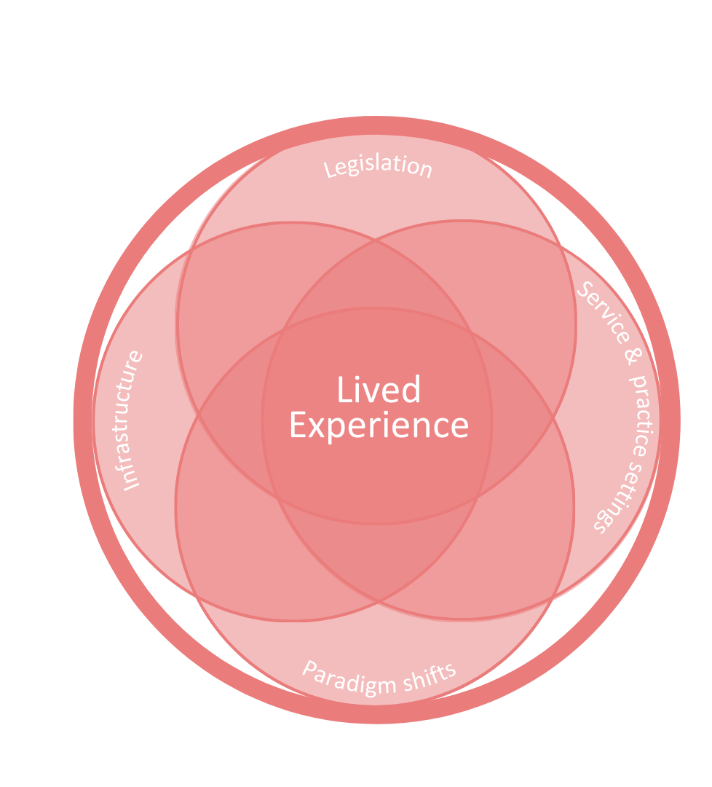
Feedback from public consultation undertaken in 2021/2022
The general overarching themes received through public consultation were:
The need to align to human rights obligations with greater autonomy and self determination
That the current Mental Health Act is being misused
The desire for the Mental Health Act to be more person and family/whānau focused
Te Tiriti o Waitangi | Treaty of Waitangi as the foundation of new legislation
Environments and workforce
Paradigm shifts are required.
Overview of the Mental Health Bill as introduced into the House on 1 October 2024

Slide 9
Lived experience feedback
People with lived experience and their families who gave feedback in the public consultation in 2021/2022 outlined the care they want to receive in the future
Responds early
People wanted a system and services that respond early to social and psychological distress to prevent acute experiences developing. For example:
Support across the mental wellbeing system are not siloed
Support is networked rather than people and families networking them
Families can access support even when their loved one is not connected to a service yet.
Holistic care
People wanted to be seen in their entirety, not just as a disorder or symptoms to be fixed. They wanted to be understood in the context of their lives, including their roles as parents, loved ones, and with expertise they could bring to their care.
Attends to causes not 'symptoms'
Understood within family and whānau relationships
Shift in singular privileging of psychiatry.
Care where personhood & dignity are upheld
People spoke of wanting to maintain authority not only of their care but also their lives. They wanted services that maintained their dignity. Examples of how this this could occur:
Decision making supports
Advanced directives
Physical environments that humanise.
Care that includes rather than secludes
People said that care needed to be less hostile and punitive which required the elimination of seclusion and greater reductions in restrictive practices. This would require:
Changes to process and practice for assessment and admission
Safe assessment spaces
Improved police involvement
Incorporation of cultural supports and practices.
Care that respects & actively protects rights
While people have a range of rights, they spoke of these not being respected or protected. Improvements could be achieved with:
Independent advocates
Mechanisms to monitor and protect are accessible, timely and resourced.
A system that learns & restores relationships
People wanted there to be an understanding that even though there is a positive intention, harm occurs through compulsion and there is a responsibility to repair and restore relationships with families, whānau and the health system.
Mechanisms for listening and learning
Action taken on the learning.
Lived Experience roles in all areas
People saw a place for increased lived experience involvement:
Peer Support roles within care
Peer Advocates providing timely and accessible support
Lived experienced practitioners and roles involved in design, monitoring, protections and accountability.
Care in environments that enable humane care
There was a call for care in new environments like peer acute alternatives.
There were also recommendations that physical environments needed change to bring about humane care. They need to include sensory modulation, be culturally safe, have access to green spaces, be fit for purpose for family and whānau, and be culturally appropriate.
Overview of the Mental Health Bill as introduced into the House on 1 October 2024

Slide 10
What is the Bill seeking to achieve?
Overview of the Mental Health Bill as introduced into the House on 1 October 2024

Slide 11
The policy objectives
A set of policy objectives have guided the development of the Bill and set out what the Bill seeks to achieve.
The policy objectives are to create a modern legislative framework for compulsory mental health care that:
shifts compulsory mental health care towards a rights-based and recovery approach
enables responsive needs-based care, including culturally appropriate care, that addresses the need for compulsory care
supports the safety of individuals and others
supports people to make decisions about their mental health care and ensures those who have decision-making capacity are not compelled to receive mental health care
minimises the use and duration of compulsory care, including minimising the need for people to re-enter compulsory care
includes effective safeguards and mechanisms to monitor the use and operation of legislation and respect human rights.
Overview of the Mental Health Bill as introduced into the House on 1 October 2024

Slide 12
What is in the Bill?
Overview of the Mental Health Bill as introduced into the House on 1 October 2024

Slide 13
Foundations for person-centred care
The Bill has foundational elements to support the shift towards a rights-based and recovery approach to compulsory mental health care
Purpose statement
The purpose statement is intended to support the application of the new legislation towards a rights-based and recovery approach and better support care that meets the needs of people.
Principles to guide decision-making
Decision-makers under the legislation must be guided by the principles in the Bill. The principles will ensure that compulsory care should only:
serve a therapeutic purpose
be applied in the least restrictive manner
be supportive and responsive.
Descriptive clause clarifying how the legislation will give effect to the Treaty of Waitangi | Te Tiriti o Waitangi
The descriptive clause sign-posts other areas in the Bill that will give effect to the principles of Treaty of Waitangi | Te Tiriti o Waitangi. This is intended to provide clarity to clinicians and others applying the legislation as well as people who are subject to the legislation.
What is in the Bill:
New purpose statement
New principles
New descriptive clause.
Overview of the Mental Health Bill as introduced into the House on 1 October 2024

Slide 14
Supported decision-making & greater protections
The Bill will ensure people are assisted and supported to make decisions about their own mental health care to the best of their ability even if they do not have capacity, or in advance of becoming unwell
Preparation before a person is subject to the legislation |  | Independent support |  | Participation requirements
People will be able to: make a compulsory care directive that makes statements about their future care, this is like an advanced directive appoint nominated persons to represent their interests if they ever become subject to the legislation. |  | Independent support people will assist people to understand their rights and participate in decisions. People will also have access to advocates to assist them to exercise their rights. This includes representing them in processes in the Bill or making complaints for them. These roles will be independent of other decision-makers in the Bill. |  | Those responsible for key processes under legislation will have a duty to ensure people are encouraged and assisted to participate in decisions being made about them.
Family & whānau involvement |  | Rights |  | Complaints & reviews
A person’s support network can be involved in key processes and will be notified of key decisions and outcomes. Hui whaiora (well-being meeting) will assist people to make decisions, resolve issues, and support restorative practices. Hui whaiora involve the person, their support network, such as their family and whānau, and other professionals involved in their care. |  | A set of rights will ensure things like a person’s right to information, and to independent health and legal advice. There are corresponding duties on specific people to ensure rights are upheld. Relevant rights extended to voluntary patients in inpatient units. |  | Complaints can be made to district inspectors who are independent watchdogs. They will be guided by principles to ensure accessibility, timeliness and transparency. There are appeal and review processes that apply at different stages of the process, including the right to seek review by the review tribunal, appeal to the court, or apply for judicial inquiry.
What is in the Bill:
New mechanisms people can put in place before becoming unwell
New roles to ensure rights of patients are upheld
New participation duty
More robust family and whānau involvement
Strengthened rights
Improved complaints and review processes.
Overview of the Mental Health Bill as introduced into the House on 1 October 2024

Slide 15
Compulsory care and safeguards for particular practices
Providing care that better meets people’s needs on their recovery journey will help minimise the need for and duration of compulsory care
Compulsory care criteria |  | Statutory processes
To be subject to the legislation, a person must have seriously impaired mental health that causes or is likely to cause: serious adverse effects in the near future in the absence of compulsory care, and the person to lack capacity to make decisions about their own mental health. |  | The statutory process sets out the different points at which a person must be assessed against the criteria to determine if they should be or continue to be, subject to the legislation. If at any time a person’s responsible practitioner considers they no longer meet the criteria they must be released. |  | At each process step in the process: decision-makers must have regard to the views of the person and their family and whānau. Decisions must also be guided by the compulsory care principles there are rights to seek review of or appeal against decisions.
Care planning |  | Expertise involved |  | Limtations, safeguards & protections for certain practices
Once a person is subject to the legislation, they must have a care plan that is based on a holistic needs assessment. Care planning will include transition planning. The care plan must be kept under review. Care can only be provided in accordance with a person’s care plan. |  | A responsible practitioner will oversee a person’s care. Among other a responsible practitioner must ensure that a rōpū whaiora (collaborative care team) is in place with the expertise required to meet the person’s needs. |  | There are limitations, safeguards and protections for certain practices including: ECT and restricted treatments tighter controls on the use of restrictive practices. In particular, seclusion where there will be a duty on people under the Act to reduce and eliminate seclusion, regulatory guidelines, mandatory reporting of use, ability to prohibit or further restrict use through regulations.
What’s in the Bill:
Updated criteria for someone to be subject to the legislation to ensure intervention is justified
Clearer statutory processes
New comprehensive care planning requirements
More expertise to meet the person’s needs
More robust family/whānau involvement
Tighter controls on certain practices and treatments.
Overview of the Mental Health Bill as introduced into the House on 1 October 2024

Slide 16
Meeting particular needs
The Bill has specific considerations and processes to ensure that care is responsive to a person’s needs and that there are appropriate protections
Children & young people The legislation continues to apply to anyone regardless of age. This means other areas of the legislation apply to children and young people, for example supported decision-making requirements and rights. If compulsory care is required, children and young people will have access to developmentally appropriate services and additional protections including in relation to ECT and seclusion.
People in the justice system Existing processes and requirements for forensic patients will apply, including that they are to be cared for in the same way as other patients under the legislation. A Forensic Patient Review Tribunal will make decisions about long leave and review the condition of forensic patients.
Care to meet the needs of the person, including cultural needs A range of requirements to ensure responsive care based on a person’s needs, for example: principle that compulsory care should reflect the needs of the person, including their cultural needs right to respect for a person’s culture and identity a care plan based on a holistic assessment of the person including cultural considerations a wider range of experts involved in a person’s care, including cultural expertise and expertise in lived experience of mental distress.
What is in the Bill:
Strengthened protections for children and young people
Improvements for decisions about forensic patients
Strengthened and new requirements to support care based on a person’s needs, in particular cultural needs.
Overview of the Mental Health Bill as introduced into the House on 1 October 2024

Slide 17
Administration, monitoring and oversight
The Bill includes strengthened monitoring, oversight and reporting requirements to ensure that the legislation is implemented as intended and that the rights of patients are upheld
What is in the Bill:
Updates to administrative roles to align with new policy intent
New roles to ensure rights of patients are upheld
Improvements to review tribunals
New reporting requirements
New requirement for regular review of legislation.
There are a range of administrative roles to ensure that processes and decisions are made in accordance with the legislation.
This includes for example, the Director of Mental Health, district inspectors and review tribunals.
New independent support and advocacy roles provide greater protections for people under the legislation.
Reporting requirements will ensure the operation of the legislation can be monitored.
This includes that services must report on matters required by the Director of Mental Health. The Director of Mental Health must publish an annual report on the implementation of the legislation.
The Director-General of Health will be required to review the legislation within 5 years of commencement and then at 5-yearly intervals.
The responsible Minister will be required to establish an advisory committee within 6 months of commencement to advise on the operation of the Bill.
Overview of the Mental Health Bill as introduced into the House on 1 October 2024

Slide 18
When would the Bill take effect?
Overview of the Mental Health Bill as introduced into the House on 1 October 2024

Slide 19
Commencement & implementation
The Bill has a proposed commencement date of 1 July 2027.
It is important that there is sufficient time to prepare services in the mental health sector as well as other impacted area such as the courts.
The Ministry of Health is progressing a programme of work to prepare and support the mental health sector implement new legislation.
Other changes taking place in the mental health and addiction system will support the Bill. For example, changes are underway through the mental health and addiction infrastructure programme and investment in growing and upskilling our mental health and addiction workforces. There is also a move in some districts to implement advanced care directives and supported decision-making.
Overview of the Mental Health Bill as introduced into the House on 1 October 2024

Slide 20
Where can I find more information?
The Health Committee has invited public submissions on the Bill. The closing date is Friday 20 December 2024.
You can find out more information about making a submission here: https://www.parliament.nz/en/pb/sc/make-a-submission/document/54SCHEA_SCF_538751B7-FEA5-4DCC-CCE2-08DCE18E31B4/mental-health-bill
If you have any questions about making a submission, you can contact the Health Committee Secretariat at: health@parliament.govt.nz
You can read the Bill here: https://legislation.govt.nz/bill/government/2024/0087/latest/whole.html#LMS994889
You can read the briefing notes developed for the Minister for Mental Health to support the Government to prepare for the introduction and first reading of the Bill here: https://www.health.govt.nz/information-releases/advice-to-minister-for-mental-health-mental-health-bill-briefing-notes-to-support-introduction-and
You can track the progress of the Bill through the Parliamentary stages here: https://bills.parliament.nz/v/6/538751b7-fea5-4dcc-cce2-08dce18e31b4?Tab=history
Overview of the Mental Health Bill as introduced into the House on 1 October 2024

