Slide 1
Medical Products Bill
Ministry of Health, November 2024

Slide 2
The story so far:
The Government has committed to repealing the Therapeutic Products Act…
…but the Medicines Act 1981 is outdated and not fit for purpose

Slide 3
On 30 September, Cabinet agreed to:
develop a Medical Products Bill to regulate medicines and medical devices – intended to be passed in 2026 and take effect by 2028
separate legislation for natural health products – to be developed over a longer timeline in consultation with consumers and the natural health product industry
Notes:
https://www.health.govt.nz/information-releases/cabinet-material-modernising-the-regulation-of-medicines-and-medical-devices

Slide 4
What will be covered in the Medical Products Bill?
IN | OUT | TBC
Medicines Medical devices Software that is part of a medical device (eg a pacemaker) Vitamins and minerals above a certain level (aligned with international standards) Gene therapies Substances of human origin (blood products, organs etc) | Food and drink Vitamins and minerals below a certain level Other natural health products, including rongoā Māori Most cosmetics and related, eg shampoo, face wash Equipment that can benefit health, eg sports gear Software used in a medical setting, eg patient booking software | Software as a medical device Radiopharmaceuticals Sunscreen
All products will be regulated in a way which makes sense for that type of product

Slide 5
Purpose
The Medical Product Bill is intended to:
support improved health outcomes for all New Zealanders by enabling timely access to safe, high quality, and effective medical products;
and to do this by providing cost-effective assurance that medical products meet acceptable standards of safety, quality, and efficacy or performance

Slide 6
Principles
regulation should be risk proportionate and support timely access to medical products;
regulation should recognise differences between product types, including the differences between medicines and medical devices;
regulation should, where possible, be harmonised with international good practice, enabling reliance on assessments and decisions by trusted overseas regulators;
the regulatory system should support innovation, competition, economic growth, and exports in a way that maintains New Zealand’s reputation as a producer of high-quality products.

Slide 7
Product approvals - indicative pathways
Full assessment
Abbreviated assessment
Verification
Self-declaration
No approval needed / notification
Not regulated as a medical product
Products not approved elsewhere
Products approved in other countries
Low risk devices
Very low risk devices
Toothpastes, toothbrushes etc
Risk level

Slide 8
Regulated activities
Prescribing
Administering medicine
Some supply activities
Licences and permits
Authorised in legislation
Professional regulation
Manufacturing
Wholesaling
Importing unapproved medical products
BAU activities for caregivers, retailers, Defence etc

Slide 9
Other key Cabinet decisions
No mandatory approval process for exports
Personal importation of prescription medicines will be allowed (with a prescription)
Clinical supply of unapproved products will be enabled
It will be easier for professions to gain prescribing powers

Slide 10
Next steps
2028 onwards: Transition period for some products
March 2025: Cabinet decisions on clinical trials, pharmacy regulation, exports, statutory timeframes, advertising, and offences and penalties
Late 2025 / early 2026: Public submissions on Medical Products Bill
2025-2027: Secondary legislation developed
More engagement with stakeholders
Select Committee
More engagement with stakeholders
Late 2025: Medical Products Bill introduced to Parliament
Mid/late 2026: Medical Products Bill passed into law
2028: Medical Products Act takes effect

Slide 11
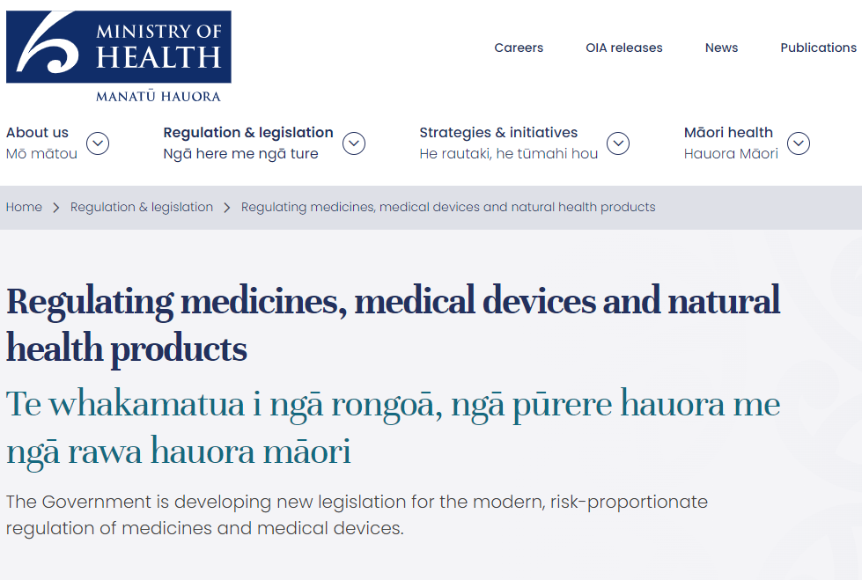
Stay in touch with us
Documents released on our
website: go to health.govt.nz
and search “medical products”
Subscribe to our newsletter: go to health.govt.nz and search “medical products subscribe”
Email: therapeuticproducts@health.govt.nz

