Slide 1
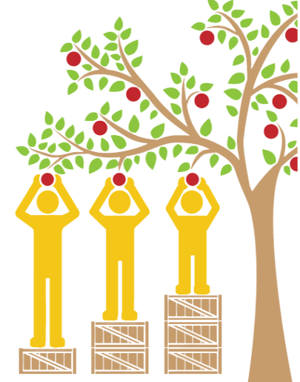
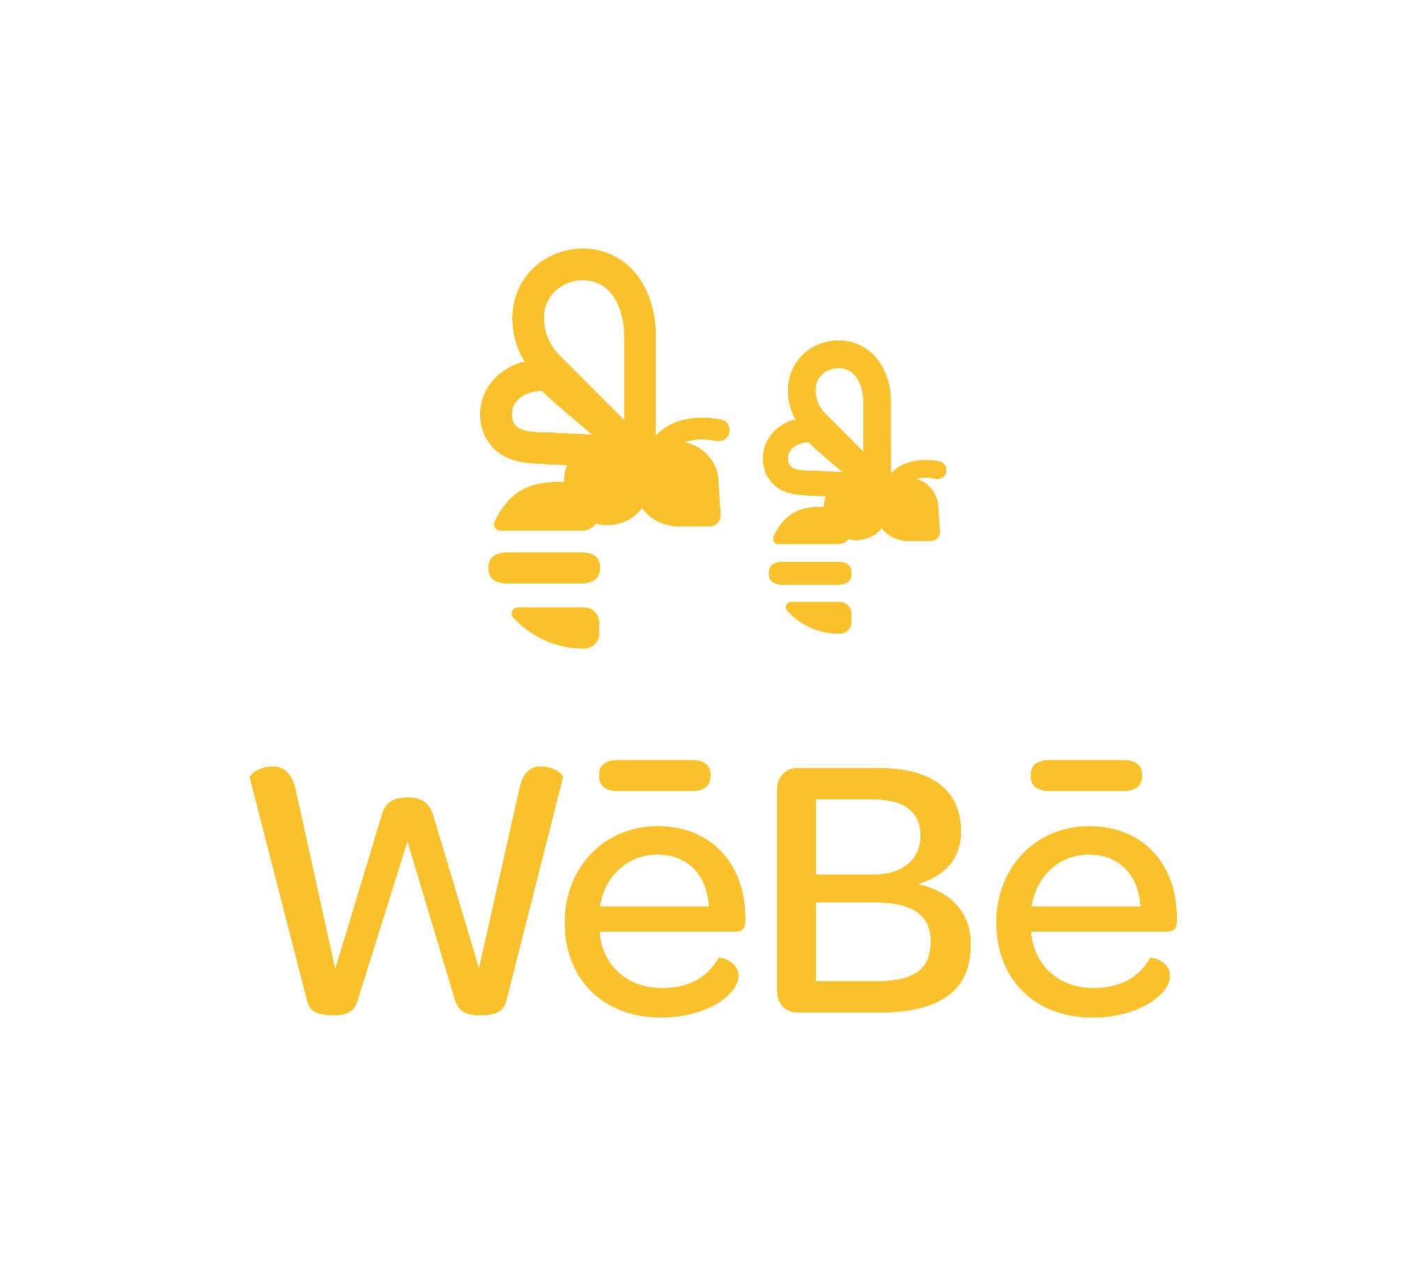
Review of the equity
response to COVID-19
Final report for Ministry of Health
July 2022

Slide 2
Names of research team:
Kirimatao Paipa (Te Rau Ora)
Dr Sarah Hayward (WēBē)
Kym Hamilton (Karearea)
Danny Leaoasavaii (The Cause Collective)

Slide 3
Executive summary

Slide 4
Recommendations
Relevant to findings:
Rec 1: Plan ahead now to ensure existing inequities can be taken into account from the beginning of any response to future pandemics | 1, 2
Rec 2: Honour Te Tiriti o Waitangi and take an equity lens in any future pandemic, including vaccination efforts, to ensure the active protection of marginalised communities and to prevent worsening disparities | 3, 4, 10
Rec 3: Always have community leaders from marginalised communities at the decision making table from the beginning | 5, 11, 12
Rec 4: Pay more attention to providing manaakitanga and meeting social needs, not just clinical needs | 6
Rec 5: Take more responsibility for providing culturally responsive health and disability services to prevent burnout of frontline Māori and Pacific workers | 7, 8
Rec 6: Build frontline health and disability services that provide whānau-centred rather than individually-centred care, and people-centred rather than service-centred care | 9
Rec 7: Tailor communications more to ensure they are culturally appropriate and nuanced for Māori, Pacific and disability communities | 13
Rec 8: Enable tinorangatiratanga and give Māori, Pacific and disability communities more control over resources for their own communities | 14
Rec 9: Collect and share more disability and ethnicity data to better monitor progress in addressing inequities | 15
Rec 10: Review what Public Health services could do to provide more culturally responsive leadership and coordination in any future pandemic | 16

Slide 5
Contents
Item | Slide number
Purpose & background | 6
Key research activities and characteristics of participants | 11
3(a). Findings: Participants’ experiences and views | 15
3(b). Findings: Positive examples that the Ministry can learn from | 45
Recommendations | 54

Slide 6
Purpose & background

Slide 7
Purpose
A note re purpose:
There have been other equity-related reviews related to the pandemic, notably the Waitangi Tribunal report, Haumaru: The COVID-19 priority report and more recently, the Equity Impact Assessment for the Omicron Public Health strategy. This review does not attempt to recover ground already covered. Instead it is focused on the whānau and community experiences of the government’s response to COVID-19. As such, it is not meant to provide a full account of the Ministry’s response to COVID-19. Instead, we concentrated on understanding the COVID-19 related needs, concerns and priorities of the Māori, Pacific and disability communities and what this highlights about how well the Ministry addressed equity for these communities.
To conduct an equity review of the Ministry of Health’s (the Ministry’s) COVID-19 response to the Māori, Pacific and disability communities
To provide recommendations to reduce inequities associated with any future pandemics

Slide 8
Ministry of Health’s definition of equity
In Aotearoa New Zealand, people have differences in health that are not only avoidable but unfair and unjust. Equity recognises different people with different levels of advantage require different approaches and resources to get equitable health outcomes.

Slide 9
COVID-19 in Aotearoa New Zealand
At the time of this research, there had been three waves of COVID-19 in New Zealand:
Wave 1 - March 2020 - ‘COVID-19’
Wave 2 - August 2021 - ‘Delta’
Wave 3 - January 2022 - ‘Omicron’
This research is relevant to all three waves.
9

Slide 10
The Government’s response to COVID-19 at a glance
The Ministry of Health was directly or indirectly involved in many key elements of the Government’s response to COVID-19. Public health played a large role in the following policies and services:
Elimination strategy and lockdowns - designation of ‘Essential services’
Infection Prevention Control (IPC) rules, eg face masks, physical distancing, hand washing
Contact tracing and case investigations
COVID-19 response unit - coordination with Local Government and the Civil Defence Emergency Management (CDEM)
Vaccinations and testing
Vaccine mandates and passes
Managed Isolation and Quarantine facilities (MIQFs)
Addressing social needs via their Manaakitanga teams
COVID-19 protection framework (traffic light system)
Communications & engagement
A note re scope:
Participants’ comments about their experiences touched upon all of these elements of the Government’s response.
This report focuses primarily on the Public Health response but we have also reported other common themes that we believe will be of interest to the Ministry of Health.
MIQ comments were
excluded because
this was the focus of
an earlier project.

Slide 11
2. Key research activities & characteristics of participants

Slide 12
Key research activities
Rapid literature scan. We conducted a rapid literature scan of health equity literature related to COVID-19.
Interviews with whānau, community stakeholders and mainstream health providers. We conducted a total of 33 interviews with 43 whānau, community stakeholders, and mainstream health providers. Of these, 14 were whānau and 25 were community stakeholders, and 4 were mainstream health providers. 8 of the whānau and community stakeholders had a disability or looked after someone who did. To ensure we could develop trust with interviewees, our interview team was made up of Māori, Samoan, and Pākehā interviewers.
Sense-making hui. We conducted 2 sense-making hui to discuss the findings and agree on the key themes.

Slide 13
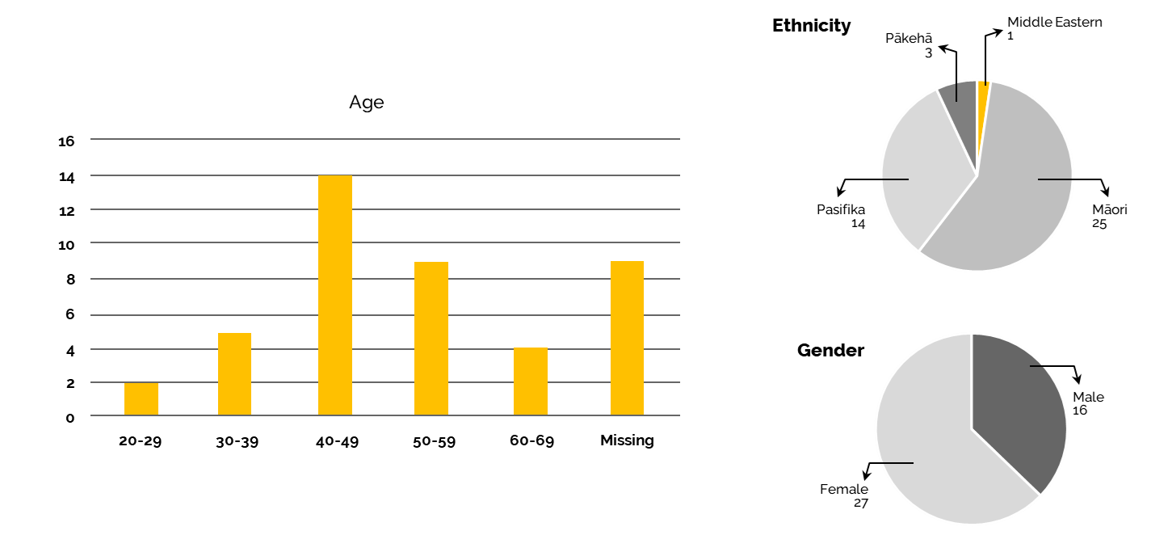
Demographics of interview participants

Slide 14
Other characteristics of participants
The community stakeholders represented a broad cross section of community providers and leaders from the following organisations:
The Cause Collective
Karearea
Public policy consultant
Māori health management and strategy consultant
Māori mental health consultant
Te Hiringa Hauora
Indigenous working group of the Governing Council of the World Federation of Public Health Associations
Pacific Ministers and Pastors Collective
Te Kete Pounamu
Te Hau Ora Ō Ngapuhi
New Zealand Disability Support Network
Aotearoa New Zealand Sex Workers’ Collective
South Seas Healthcare
Manurewa marae
Maraeroa Marae
Kauwhata Marae
Iwi Leadership Rōpū
Palmerston North City Council
Highbury Whānau Centre
Te Tihi o Ruahine
MidCentral DHB
Of the four mainstream health providers we interviewed, 3 were Māori and 1 was Pasifika. They worked for different parts of Regional Public Health services.

Slide 15
3(a). Findings:
Participants’ experiences & views

Slide 16
A note about the presentation of our findings:
A note about the presentation of our findings:
The headline themes presented in this section are from participants’ point of view. They are not exact quotes but represent the most common sentiments expressed by
participants. Exact
quotes are represented
within quotation marks.

Slide 17
1. You didn’t plan ahead enough
“...if the Government can see how bad the outbreak is overseas, they need to plan in a way…think in a way that the outbreak is already here before it even gets here; instead of planning for it after it gets here.” - Whānau with disability
Participants’ comments reflected that bureaucracy led to unnecessary delays in responding and a failure to plan ahead.
Where resources were slow to arrive, Māori and Pasifika just got on and did what was needed. They didn’t wait for the system.
There was a belief expressed that the Ministry could have done more to prepare ahead, based on looking at what was happening overseas and knowledge of existing inequities for the Māori, Pacific and disability communities.
“There was far, far, far too many hui across organisations, Government organisations, way too many; and nothing was getting done about it.”
- Mainstream Health provider
“Ideally, we don’t want to be… relying on the tit of the government. We want to exert our own rangatiratanga in a way that we service our own people in our own manner. So that’s the ultimate goal, but that’s a bit further down the track.”
- Iwi Leadership Rōpū
“The Asians were already way ahead of the rest of New Zealand, I should say because they were already 6 months ahead doing things. I just watched their behaviour…but noone really asked them or talked to them, and that’s when it all started.”
- Community stakeholder
“There are huge things, but we just did it, what our whānau needed.”
- Iwi Leadership Rōpū

Slide 18
2. Our existing needs weren’t taken into account
“..whereas we were pretty much left in the dust, and the only people we could reach out to were our reverends, our pastors… but the church can only do so much… most Pacific churches are not for profit and the fact is don’t have much money to give out.”
- Whānau with a disability
“What I found is calls that were coming into the Call Centre were our Māori and Pasifika whānau. There was overcrowding, there was lack of food. It was getting cold, so we were going into winter. So they had issues with heating and things like blankets and all that.” - Mainstream Health provider
A common sentiment was that the COVID-19 response did not account for existing inequities.
Participants evidenced this by the lack of Health prioritisation of Māori, Pasifika or people with disabilities who already had greater levels of need at the start of the pandemic.
They also suggested that certain actions, such as pulling nurses out of circulation to help with the COVID-19 effort, exacerbated existing inequities.
Participants suggested that Te Tiriti o Waitangi should always be honoured to ensure an equity lens from the beginning. In practice, they thought this would mean establishing a Māori response team for COVID-19 from the beginning, along with a Māori roll out strategy and a Māori system for those who wanted it.
“I said, ‘You cannot take the nurses out of the schools because they are the ones that are able to have good oversight over what’s happening in homes.’ They ignored that and I said, ‘You carry on like this, you will exacerbate the disparities between Māori and non-Māori.’ And it has got worse.” - Mainstream Health provider
“They (Māori) should be at the top of the list when it is needs based, because our people continually miss out.” - Whānau with a disability
“If you want to take it back there (to TTOW)... We are your partner in everything you do; it is not what works for Kiwis works for all, because we don’t even identify as Kiwis. They should have created a Māori response team right at the beginning.” - Whānau Māori

Slide 19
On Equity:
As far as I can tell is, and in fact the Tribunal said the same - the Crown put aside equity; equity of access and equity of outcome. The inability to engage properly; the misunderstanding that active protection is an important component of equity; each time they have made a decision from COVID to Delta to Omicron, our providers are left worse off, not better off; our providers are key to securing equity and equitable care; I… think… that not actually accounting for Māori health needs in that first roll out meant they left us with disproportionate risk of being infected compared to other population groups. They actively supported inequity, actually.
- Community consultant

Slide 20
3. The vaccination strategy put us at further disadvantage
“They ask you to ring up and book but never took into account… the first one they sent me to a place I couldn’t access because it had no ramp for my wheelchair to get up..” - Community stakeholder
“...it is not about someone telling; maybe a little bit about that but underneath it all, it was about her understanding of the health system and her trust in it.”
- Whānau Māori
As is consistent with the Waitangi Tribunal’s Haumaru report¹, participants reported that the vaccination strategy breached active protection obligations and exacerbated existing inequities.
This was primarily as a consequence of people being prioritised for vaccinations on the basis of age, with the oldest eligible first. The Māori population is younger on average than the general population, so this resulted in Māori receiving later vaccinations, even though they die about 10 years earlier than non-Māori. To have prevented further disadvantage, the vaccination strategy should have been age-adjusted for Māori.
Additionally, it could have been predicted that due to legitimate historical reasons for mistrusting the Government, Māori would be less likely to get vaccinated.
Although some participants said they had easy access to vaccinations, others found the online booking system difficult to use, and those with disabilities were sometimes expected to stand in line for vaccinations.
“...especially when you consider the average life span of a Māori person is 10-15 years younger than Pākehā, so our old people aren’t even the old people who were eligible to get the vaccine first, even though they are our kaumatua and we already know that our access to health services was significantly less, so I was annoyed at the Māori rollout, how that went..” - Whānau Māori
“The appointments were often 2-3 weeks out. For people who are on gig economy and shift work, we only get it a week out. You actually couldn’t book; if you could get online… (because don’t know your schedule).”
- Community stakeholder
“Vaccination prioritisation is not about race, but it should be about need.”
- Whānau Māori
1 https://waitangitribunal.govt.nz/assets/Documents/Publications/Covid-Priority-W.pdf

Slide 21
The vaccination strategy put us at further disadvantage cont.
“The only old people who did well out of it are actually people like me because I am over 65, so I got that (vaccine early)... not because I’m Māori, but because I’m old.”
- Whānau with a disability
“So the original vaccine thresholds did not account for Māori health needs, which meant that our people were put at disproportionate risk from Delta in comparison to every other population group. That is a breach of protection and a breach of equity.”
- Community stakeholder
“...they (MoH) could have made sure that the Crown’s vaccination strategy was consistent with Te Tiriti and its principles.”
- Community stakeholder

Slide 22
On the vaccination rollout:
I think also that the vaccine rollout is probably the most salient example of inequity when we’re looking at how it was rationed… to the age and population which failed to actually embrace where the majority of our vulnerable population are; which we know through our data and through the mahi that we do. So we could have got our whānau vaccinated sooner, better, faster if the Crown had listened to where it was we needed to support our whānau that were in vulnerable situations.
- Iwi Leadership Rōpū

Slide 23
4. The vaccination mandates and passes made things even worse for us
“So something that I’d been doing for years all of sudden I wasn’t able to do it. I lost all my jobs.”
- Carer for whānau member with a disability
“And so that is the role of a carer, to identify that (eg, bed sores); they come and do daily check-ups. But even the slightest little red mark, those (at the) ADHB are trained to pick that up but parents and siblings have no idea what that is, so we had a lot of people falling ill during lockdown because of that.”
- Whānau with disability
While some participants appreciated the vaccination mandates and passes, they disproportionately affected Māori, Pacific and disability communities.
Those frontline workers who were vaccine free lost their jobs. As a result, there were fewer frontline workers, reducing overall levels of care for others.
However, vaccine mandates also affected carers’ ability to care for their own whānau.
The loss of care was a particular issue for the disability community, leaving many: (1) without any care, or (2) having to rely on whānau members with no training in how to support them, or (3) a revolving number of strangers coming through their doors who did not understand their needs as well.
The mandates and passes also contributed to division within whānau and communities.
“I don’t like random people turning up at my house. I understand they have many people to deal with. But when you are expecting one person and another walks through the door who doesn’t understand my idiosyncrasies. I get angry about it.”
- Community stakeholder
“Yeah, I had friends arguing about it (vaccination); facebook friends.”
- Whānau with disability
“Just no support; it made us feel like not a 2nd citizen, but a 3rd citizen; we didn’t feel like people; we didn’t feel like citizens of the country because we were put in the background. We were just ignored all the time.”
- Whānau with disability

Slide 24
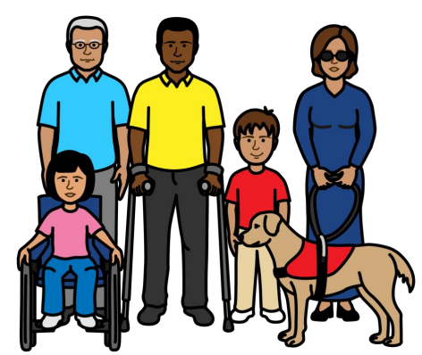
4. The vaccination mandates and passes made things even worse for us cont.
“…someone put on social media that I’m not vaccinated and I should be because of the dangers… and the shop, the pub, whatever. And then from that it just spilt fear, you know, and the next minute they (group of local kaumatua) were attacking me and calling me selfish, and I’m just bloody selfish and all of this for not getting vaccinated. I thought, wow, you know, after 11 years of looking after them, next minute I was getting abused. I thought, well I’m not even gonna have the (kaumatua) lunch… because I don’t wanna put myself up to be abused for personal choice.” - Carer for whānau member with a disability
“The process is difficult for some people with disabilities. Not easy for many to stand and scan the QR code. It is impossible for me as a physically disabled person; makes me embarrassed.”
- NZ Disability Support Network
“Because people are fearful of COVID or you can’t come here. That’s affected me too. You can’t come here because you haven’t been vaccinated.”
- Whānau with disability
“Mandates have undone the investment of years of training within the workforce.”
- Community stakeholder

Slide 25
On the vaccination mandate:
Like [sister] wouldn’t come down and visit mum because we’re not vaccinated. And then I said to her, ‘Well that’s okay. If mum dies and we can’t go to the marae because they don’t have vaccinated people then you’ll have to do it on your own, because I can’t come.’ ‘Oh, I can’t do that (she said).’ I said, ‘Well that’s what you’ll have to do.’ In the end she burst into tears and “Oh, we won’t be going there (to the marae) then.’ …the sad thing… was I missed out on a lot of time with mum before she died because of those issues..
- Vaccine free carer for whānau member with a disability

Slide 26
5. You didn’t understand us and weren’t sensitive to our cultural and unique needs
“We went to huis at the Ministry of Health; put forward ideas; their scenarios were based around white middle class; someone who had a mobile; that sort of thing; had the technology; I gave them a scenario from us - brown, no phone, no other devices; so how are you going to engage with them? They still didn’t quite get it.”
- Community stakeholder
There was a lack of cultural responsiveness and understanding of unique needs.
Māori felt that Pākehā didn’t understand how Māori operate as a people and that this ignorance perpetuates biased policies and services and failure to do anything different.
Making mask wearing mandatory upset many in the disability community, some of whom have breathing problems. Even though they could ask for a mask exemption, they still received abuse from members of the public..
“The thing that Pākehā don’t get is that there is a reason why we might stand up and say this isn’t right. But they haven’t actually understood it; they have no knowledge of us at all. They have no knowledge of what it is to be Māori and the way we operate as people. And so, a lot of it is unseen; they don’t see it; they don’t see the need to do anything different.”
- Whānau Māori
“And then I went to my local disabled organisation for a mask exemption; I went on the train without a mask and then the train guards pretty much yelled at me saying to put a mask on. I showed my exemption and they still didn’t accept it, saying that this is fake. How can I fake my own disability?”
- Whānau with disability
“But I was giving them (the new managers) the best advice, but it actually was making me really angry and upset and made me look at them in ways of, like you ugly, white racist pigs. You know, you're just disrespecting us so much that I really want to punch your face in; you know like that, because that was the atmosphere that they were producing.”
- Mainstream health provider
“I had a big white Pakeha boss, she's really lovely, but she knew jack shit about… equity”
- Mainstream health provider
“Even then the process for engaging was quite complicated. For a lot of our people, they would just say yes, yes, yes, even though they mean no, no, no!.”
- Whānau, Pasifika
“Ablest attitudes disable us.”
- Community stakeholder

Slide 27
You didn’t understand us and weren’t sensitive to our cultural and unique needs cont.
“You might talk to someone who might not understand the disability side. They might say that is outside my field of knowledge. Why did I waste 2 hours of my life when they can’t do anything anyway.”
- Community stakeholder
There were many examples of public health services misunderstanding whānau who were calling for help and then negatively attributing the behaviour of whānau when they understandably got frustrated.
“They were more worried about being seen to do contact tracing, to be seen to case manage cases that were in Auckland. Like, really? We’ve got families here (in Wellington) who have no food in their cupboards in your region and you’re not doing anything.”
- Mainstream Health provider
“So we had our Pākehā nurses ring then, the first thing that they’d do is, ‘Hi, Row-pata, …’ They can’t even say their name properly. I had to pick up… calls to a client in Otaki because she was feeling so insulted by the nurses, and then they all started judging her.”
- Mainstream health provider
“And it wasn’t until I connected with her… that she would talk to me. But what I was hearing from our Pākehā colleagues is, ‘Oh, she’s really aggressive, she’s not doing this and not doing that.’ And when I rung her it was because of the way they spoke to her.”
- Mainstream Health provider
“There was one case in Tauranga. This guy had gotten out of prison and the case investigator was Pākehā and she was elevating him to the Police and I said, ‘Why are you doing that?’; and she said, ‘Oh he was swearing at me.’; and I said, ‘What was he swearing at your for?’ I rang the whānau; it had nothing to do with that; he didn’t understand what she was saying...”
- Mainstream Health provider
“Our people are ringing for help and they are getting told off. Not just our people; it was across the board.”
- Mainstream health provider

Slide 28
On the lack of cultural responsiveness:
I saw and I experienced the white way instead of the right way.
- Mainstream Health provider

Slide 29
6. You didn’t provide enough manaakitanga or meet our social needs
“They’re at end of life a lot of these people that are going there, and they’re not allowed in the door. And it’s like a stormy day, windy, cold and they’re making them sit outside in the cold and mum’s got… cancer” - Carer for whānau member with a disability
“Had care packages arrive and wondered where they came from; sent little things I wasn’t expecting. Went a long way to keeping me on the straight and narrow path.”
- Community stakeholder
Lockdown meant there was no access to customary kai, which many whānau rely on to feed their families.
We heard from participants that even though Regional Public Health services had a Manaakitanga team, and some whānau felt adequately supported, there was nevertheless an overall lack of manaakitanga and attention to meeting social needs.
This was manifested as a lack of: korero; taking the time to explain the situation; flexibility regarding rules; listening; and doing what was needed to meet people’s urgent needs.
Participants’ comments also suggested a lack of manaakitanga from other Health services and Government agencies, such as being made to wait outside the GP practice in the cold and wet, even with a life threatening illness.
“There was one guy in particular who was living on a boat and he would use the toilet for bathing, for getting running water and then council locked those toilets off.” - Mainstream Health provider
“The Ministry might say - this is the only time available. You either take it or leave it. The attitude of the Ministry shouldn’t be like that; they should be working with us. If that time doesn’t work, how do we get you..”
- Community stakeholder
“... a Māori psychosocial strategy should have been key from the start given what we already know about vulnerabilities.”
- Community stakeholder
“Public health didn’t even understand what welfare meant; they thought welfare was the welfare of the workers; but welfare actually meant the welfare of the people that were affected.” - Mainstream Health provider

Slide 30
7. The burden of providing culturally responsive care fell on us
“So whereas the public health advisors like myself, which… were more Māori and Pacific than they were Pākehā, we were all put down to manaakitanga.”
- Mainstream Health provider
“Generally, Māori who are working in those Crown agencies had been our arms, legs, eyes and kōrero, kaikōrero, inside of those respective agencies, and they have helped to bridge the gap which we are extremely grateful for.”
- Iwi Leadership Rōpū
Many local providers, both Government and nongovernment, had to build capacity and capability quickly to meet the demands of providing new COVID-19 related services.
However, mainstream services struggled to engage Māori and Pasifika.
Many comments reflected that the responsibility of providing manaakitanga and culturally responsive care was largely left to Māori and Pacific frontline workers in either mainstream or Māori or Pacific organisations.
“So we were dealing with everything coming at us but we didn’t care because we were dedicated to the kaupapa. So our kaupapa was - not one life. Not one Māori life; not one Pasifika life. So we named our response - Te Ira Tangata (saving whānau).”
- Mainstream Health provider
“It came together sometimes, but we didn’t have any big expectation around that because it was a pandemic. Whatever awhi we can offer people or they can offer us… we will take it. We were open to it. I support the Whānau Ora concept.”
- Community stakeholder
“Because we saw the difficulties that the white people were having with our people..”
- Mainstream Health provider
“So there were Māori within the organisation (Public Health Unit) that connected with Māori providers, so they worked with them and that’s how community were supported that way.” - Mainstream Health provider

Slide 31
8. We were exhausted
“Our providers are completely burnt out. They have had to work against the system in the first wave and then three times against the system in the second wave - the Delta. And by the time Omicron has come, they are exhausted and still aren’t paid the same as their colleagues, particularly the unregulated workforce.” - Community stakeholder
Partly due to the extra burden of care, Māori and Pacific frontline workers reported feeling mentally and physically drained by the pandemic.
Many worked additional hours to meet the needs of their communities.
The high stress levels were also associated with a lack of support from senior staff with the Public Health services.
“It was very mentally and physically and emotionally draining for me, and I had absolutely nobody at a management level to support me; and that’s very taxing.”
- Mainstream Health provider
“The other thing is that our core business, most of our staff are 50+ and we all carry long term conditions as well from diabetes to obesity to… our kaumatua got cancer during the first lockdown, so all that. So we pulled out to protect ourselves really.”
- Community stakeholder
“So I got myself out of the COVID space, because it was really, really, really stressful. It was stressful, not only just on me, but for most of our Pacific and Māori staff there.”
- Mainstream Health provider
“And because our numbers of Māori and Pasifika within the Public Health Unit are low, they were either inundated and overworked, or communities just weren’t served.”
- Mainstream Health provider
“Our Hauora providers are broken.”
- Community stakeholder

Slide 32
9. You thought about your staff but not my whānau
Related to a lack of cultural responsiveness, participants suggested that the COVID-19 response was individually- and service-centred, rather than whānau- and people-centred, respectively.
The lockdowns within self-contained houses did not take account of Māori and Pacific collective structures across households.
In one example, the primary carer of a cognitively disabled whānau member was unable to travel with her by ambulance to the hospital.
“What our system has done - it has given attention to the deliverers of care, not to the recipients of care. So they determine what happens to suit them. And we have to get past that; that isn’t the way for the modern world; for anybody.” - Whānau Māori
“I think that’s probably the thing that’s unique is that we’re Māori and we understand that we serve the people that we work with, or for; rather than being - they’re our customer and they owe us.”
- Iwi Leadership Rōpū
“I did all the talking for mum, I’m her primary caregiver. She doesn’t really know what’s going on because she’s just struggling to be well. I administered her medication, and we’re talking morphine, high drugs sort of thing. And did all her thinking for her basically, and yet I wasn’t able to go to the hospital with her.” - Carer for whānau with a disability

Slide 33
You thought about your staff but not my whānau cont.
Many of the negative comments we heard about the service-centred approach related to participants’ experiences when they called the COVID-19 helpline.
“They want to be heard and that is the language that they know, so let them go. Cos you should be able to… sift out what the real problem is. And it is definitely not you, but you have made yourself the problem.”
- Mainstream Health provider
“And so those white people were doing exactly that; it was like a position of power; you have COVID and I’m the one who will help you and if you don’t listen to me, the way I am going to tell you, then you are not going to get my help; that is my analysis of it.”
- Mainstream Health provider
“...people were swearing at them and hanging up. And so they (regional Public Health staff) took offence to that, and so the focus became - how do we support our people on the phone so they are not getting abused? Well how about you turn it around and say - how are we responding to these people?” - Mainstream health provider

Slide 34
10. We found it harder than others to access the health and disability services we needed
“Because get this - people that work for these disabled organisations were not marked as essential services. And I was like - how is that even possible because they are providing us with essential information that gets us through a virus.”
- Whānau with disability
“And then when they (ambulance) came they assessed her and they talked her out of going to ICU because they said, ‘Oh, she’s just gonna get to ICU and sit in the corridor for the next four hours even though she’s… on an ambulance, because they’re run off their feet’.” - Carer of whānau with a disability
Health and Disability services have been stretched by the pandemic. This has disproportionately impacted marginalised communities, further exacerbating inequities.
The lack of disability support workers due to the lockdown, vaccine mandates and illness, meant that many people with disabilities received no or suboptimal care in their own home.
Mainstream health services were also affected. We heard examples of whānau struggling to access: primary care, ambulance, hospital care, hospice care and helplines. One whānau member reported waiting 3-5 hours for their call to a helpline to be answered.
Sometimes disabled whānau only received the treatment they needed due to strong advocacy from whānau members.
“Anyway, she rang an ambulance… she needed to go to hospital. That was half past ten. The ambulance never got to her till one o’clock because they were coming from Hastings, and they’re run off their feet.”
- Carer of whānau with a disability
“COVID has affected my ability to access health services very hard, because many services losing staff due to COVID, so it has been difficult.”
- Community stakeholder
“These nurses are run off their feet. Like I said, ‘You need to work with me, I’m the primary caregiver, I’m not trying to tell you how to do your job... But… I know when she needs - the medications, what her body’s doing, everything; because I’ve been doing it for two years. I’d get a nurse who would just argue with me.”
- Carer of whānau with a disability

Slide 35
We found it harder than others to access the health and disability services we needed cont.
“There’s a big communication breakdown between all the services at the moment. They’re passing the buck on a lot of their care.”
- Carer of whānau with a disability
“It was really hard for them (people on Supported Living Payment who are homebound) to get access to anything because, one, you’d have to ring a number and then wait for hours online. Then if you got cut off it was just frustrating.”
- Community stakeholder
There were also stories of health information not being properly transferred from one health provider to another. In one example a hospice had not transferred the latest medical records to a hospital, affecting the care of a sick, disabled whānau member.
Exacerbating things further, particularly for the disabled community, was a lack of transport options available during the lockdowns. This made it even more difficult for them to travel to essential health appointments or go to the supermarket.
Interestingly, most Māori and Pacific participants found it relatively easy to access testing. This was not always the case for people with disabilities, some who found it more difficult to stand in line or administer a RAT test for themself.
“...anyone could test all around Tāmaki… and I’m just being honest, you could go and walk into a chemist and test.”
- Community stakeholder
“Some organisations because of a shortage of staff couldn’t offer services for people with disabilities…We rely on disability organisations and rely on their community… rely on the Government system; on the Government’s response.”
- Community stakeholder
“You have travel constraints as well. Not as easy to just hop in a taxi and go to appointment and come home again.”
- Community stakeholder
“I basically think mum would be still alive if she was getting the services that she needed.”
- Carer of whānau with a disability

Slide 36
11. We were not at the decision making table
“You look at the stats globally. I’m really proud to say of our Pacific nation that the Government’s done a good response. I mean there’s some things they would have probably done too late and thought, oh, gosh, let’s make sure we’re inclusive of these diverse communities. It was too bloody late because we’re coming to the end of (COVID)... But it should have been from the beginning.”
- Community stakeholder
Local community leaders understand their communities and have the cultural knowledge, relationships and networks necessary to support the health and wellbeing of disadvantaged and marginalised communities.
There was strong collaboration between DHBs and Māori, but only in pockets. There was also consultation, but it was often late. In addition, many are tired of being on Advisory groups and instead want to be included at the decision making table.
We heard examples of Health failing to listen to community leaders, such as Māori doctors who were providing advice about how to reduce inequities.
“I think the DHBs were more engaged with that because …their funders and planners kept engaged with us right throughout the process, whereas the Ministry were a bit more remote and less responsive.”
- Community stakeholder
“I think the big barrier was that the Ministry didn’t listen to our people, they listened to whatever they wanted to do and whoever was sitting in those spaces that thought it was good, that had no reality of what actually was happening on the ground.”
- Iwi Leadership Rōpū
“We were able to get a Māori and a Pacific response manager in there but they were not at the helm of making decisions.”
- Mainstream Health provider
“I would say we see pockets of mana motuhake but we do not see tinorangatiratanga, because I don’t think at any point the Crown even reached that bar.”
- Community stakeholder

Slide 37
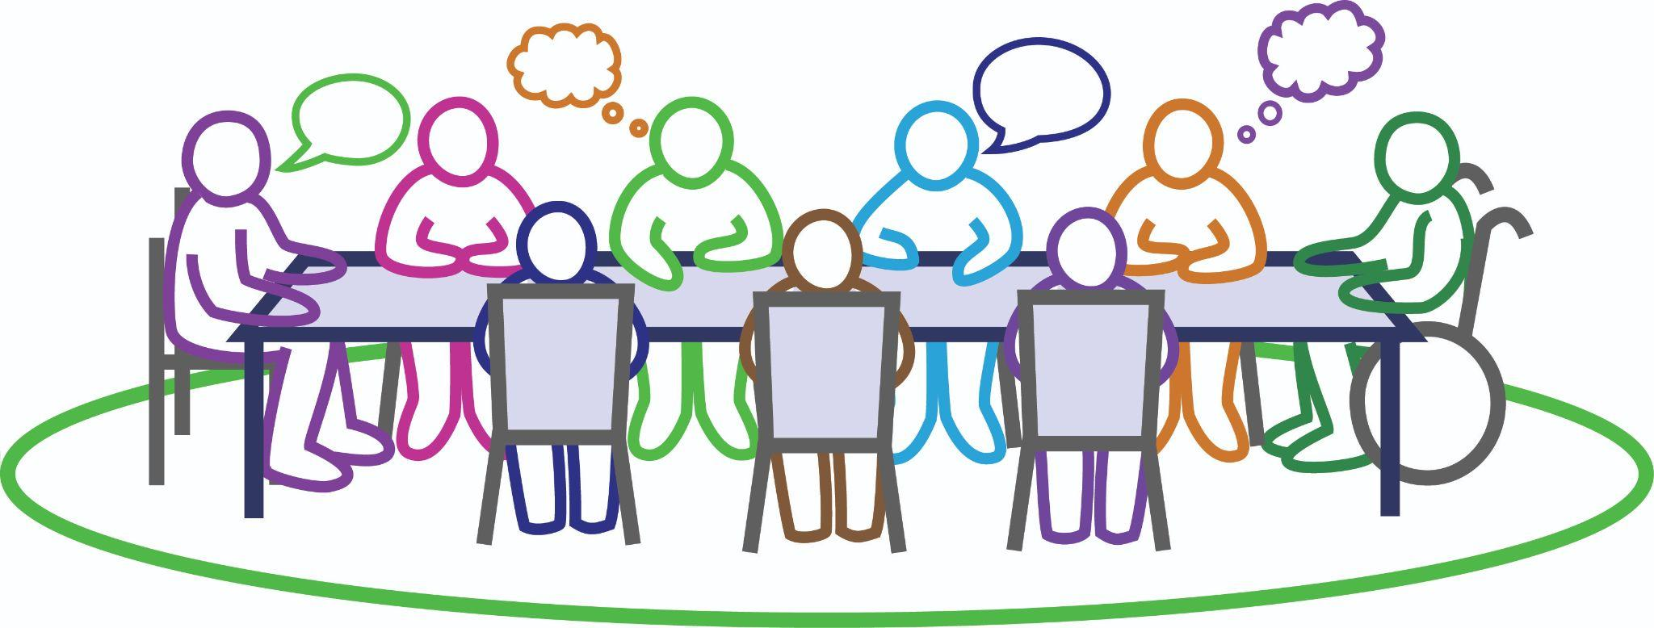
We were not at the decision making table cont.
“...but please make sure that we have good representation on an Advisory Group that can sit with those geeks and be able to write the programmes and implement that it can reach the target audience, respectfully, culturally and not be so fricken Pākehāfied.”
- Community stakeholder
“Part of why I left in the first place. My voice was never listened to and another reason was because I was saying, ‘No, you can’t do this. No, you shouldn’t do that’.”
- Mainstream Health provider
“So then all of a sudden, we get a list of all of these people that we think's really good (for the Surge Capacity Team), Māori, Pacific, everyone, you know, the whole thing, we had in the list… next minute, no, none of them gets chosen or picked. ”
- Mainstream Health provider
“One of my colleagues from the Te Tai Tokerau; all Pākehā; put up wonderful diagrams of how they were going to navigate the (gang) whānau and I said to them, ‘have you fellas spoken to [name]; she is from Te Tai Tokerau; she has whānau up there; we got connections up there. Her cousin is the leader of the Black Power; let us do it’. They wouldn’t.”
- Mainstream Health provider
“We knew we needed to have a voice. Even that in itself was difficult because it was white people at the helm of it. They didn’t want us; they just wanted our knowledge and our skill.”
- Mainstream Health provider
“I think inclusiveness is really important and working with grassroots organisations with key populations from marginalised communities in particular; that they reach out to us.”
- Community stakeholder

Slide 38
12. We can’t always use a mobile phone or the internet
“Even though you got a vaccine pass that might seem simple to someone our age, but an old person, that’s very daunting all that stuff. ”
- Carer of whānau member with a disability
A prominent need that was highlighted during the lockdowns was for digital access - to stay connected.
However, many in the Māori, Pacific and disability communities don’t have the credit to be able to use a phone or access the internet. And even if they did, many don’t have the digital literacy necessary to make online bookings or scan a QR code.
This resulted in many feeling left behind or digitally excluded.
“..people just don’t have the money for credit and things like that (IT)..”
- Community stakeholder
“This older lady came to my house crying… ‘I need to get my roof fixed and I need money.’ But … they just closed all the banks in Waipuk… And I said, ‘Well, ring the phone banking.’ She just burst into tears, ‘I don’t know what to do! I don’t know what to do!”
- Carer of whānau member with a disability

Slide 39
13. We felt confused and anxious by some COVID-19 communications
“...the whole nation was confused about COVID, but the people in the disabled community were confused even more.”
- Whānau with disability
“..the most frustrating part was when they talk on the phone and try to get help from the Helpline, they don’t have a translator.”
- Whānau with disability
Some said they thought the Prime Minister had done a good job with the messaging about the team of 5 million, and many used the Ministry’s website as a source of information and truth about COVID-19.
But participants’ comments commonly reflected that they believed there was a lack of communication overall. This was particularly the case when someone tested positive for COVID and Public Health was in contact with them. Many of these encounters left whānau with unanswered questions about how to keep their whānau safe.
There was also a lack of communication with respect to the COVID Protection framework (Traffic Light system), which many seemed confused about.
People were also confused about the workers’ subsidy scheme. We heard about some employers not understanding the subsidy scheme and asking symptomatic employees to come to work after a negative RAT test.
Others were frustrated about the communications or communication options, such as when no translator was available to translate the messages into their first language.
“And I think one of the biggest fails as well - was pushing - ‘use your legs’ rather than ‘use your hands’. But a lot of people in the disabled community, the whole reason we have wheelchairs is because we can’t use our legs.” - Whānau with disability
“I think also the inequity had a lot to do with communication and particularly as we moved into the traffic light zone, that the communication wasn’t adequately socialised nationally, and particularly with our Māori whānau who had been really naturalised into a lockdown methodology but there was no transitioning of whānau to understand this new approach.”
- Iwi Leadership Rōpū
“ …just more comms; better comms; just better guidelines; just making families and certain individuals that don’t usually cater to these needs; what they should be aware of.”
- Whānau with disability
“We were having to develop our own (comms) because our people didn’t understand what was coming through the Ministry.” - Iwi Leadership Rōpū

Slide 40
We felt confused and anxious by some COVID-19 communications cont.
“The (comms) products did not reflect how we understood our world…”
-Community stakeholder
“Because I’ll tell you what, our community has had to face a lot of media flak during COVID, and politically as well… It was put up everywhere, on the paper, on the bloody thing.”
- Community stakeholder
Sometimes, there was not a strong enough rationale given for some COVID-19 rules, which reduced people’s compliance with them, for example, being required to wear a mask when flying or going to a restaurant, but not having to at a concert of 3000.
Communication campaigns such as ‘Get your Dot’ and ‘Protect our whakapapa’ were mentioned. However, participants suggested that, overall, communications were not sufficiently tailored to the different communities. Related to this, participants suggested there were few Māori presenters in the mainstream media (TV).
Yet other communications were stigmatising, such as what happened in relation to the Delta outbreak amongst the Assembly of God (AOG) Pacific community in South Auckland. The public heard that this community was ‘not cooperating’, when really they just didn’t understand what they had to do.
Misinformation on social media was also an issue. For example, we heard about vaccination conspiracies that whānau were exposed to on Facebook.
“They (sex workers) didn’t have COVID, they weren’t reachable to the mainstream information.”
- Community stakeholder
“ I think media built a lot of fear in people.”
- Carer of whānau with a disability
“They just didn’t know how to operate smart, like adopting other Government agency’s.. who were developing resources, ie, Pasifika peoples had amazing messaging and that was going out to Pasifika people themselves. Public health were probably the worst at getting messages out, worst.” - Mainstream Health provider
“I did not understand why people were confused about the COVID regulations … until I got COVID and I was receiving different information from different places.” - Whānau Māori
“It doesn’t matter how many millions of money you put into messaging, it has to be delivered by our people for our people, not in a Pākehā framework.”
- Community stakeholder

Slide 41
14. We would like resources
to be more freed up to support the efforts of our community leaders
“I think it’s the opportunity to advance the kōrero that the freeing of the resource and the support of Māori leaders in communities is the way forward to address a number of social and health issues, not just the pandemic.” - Iwi Leadership Rōpū
Resourcing provided by the Government was frequently mentioned as an enabler for COVID-19 related services, particularly earlier in the response.
However, there was a desire expressed for more funding to be freed up to community leaders, including disability providers.
This would enable Tinorangatiratanga.
“So you know, the first round, everybody came to the party, MSD, you name it, everybody came with all their pūtea, it was awesome. The second round, they says, "No, we're not going to give you any money.”
- Mainstream Health provider
“It would be good if MoH listened to the story of providers. They are struggling with funds; they don’t have enough staff.”
- Community stakeholder
“...it (funding) is still the drip feed - it is going through a pipette instead of a bloody great (fire hose).”
- Whānau Māori
“..we got the funding (from MSD), so the funding was able to secure us a shop in the heart of Taita community. And we were able to run our food bank from out of there, as well as put a secondhand clothing shop.”
- Mainstream Health provider
“Bc obviously it was new at that time it was well resourced.”
- Mainstream Health provider
“I think the main thing the system is good for is paying money to fund it.”
- Whānau Māori

Slide 42
15. We would like you to collect and share more data with us so we can better monitor inequities
Where data was available, it was helpful. For example, data that Capital and Coast DHB provided to Maraeroa Marae helped them to plan their vaccination approach.
However, we heard about several struggles to get access to vaccination data to ensure the most vulnerable were vaccinated. We understand this was due to the Ministry’s concerns about the Privacy Act. However, eventually solutions were reached and data was shared, albeit much later than was requested.
Participants were worried that not enough ethnicity data was being systematically collected to monitor inequities and accurately inform future pandemic planning.
Concerns were also expressed about the lack of data available on people with disabilities, which prevented accurate planning regarding how to meet needs.
“The main problem is we are left behind because they don’t have data about us. For example, in the case of Wellington City Council, they wanted to expand and develop their emergency plan in response to COVID but the main problem is they don’t have data. I am based in Porirua, but they don’t know how many disabled people live in Porirua.” - Community stakeholder
“Our agencies could not get the data on who had and hadn’t been vaccinated, and I think that was the subject of a High Court matter. It meant that our providers had to work triply hard to get our people vaccinated.”
- Community stakeholder

Slide 43
16. We would like Public Health to show more leadership and kotahitanga
“..many of the problems with resourcing, whether data or PPE or RATS is … because the system is so disconnected and so confrontational and always arguing with one another.. I’ve spoken to DHB managers and they would actively do whatever the opposite of whatever MoH recommended through this.”
- Community stakeholder
“So as far as I was aware, internally for Regional Public Health things were going, you know… it was new. So we were developing and working towards achieving the best outcomes for our community.”
- Mainstream Health provider
Participants’ comments suggested that things went smoothly and there weren’t many problems with Regional Public Health services in the first wave.
However, with later waves of COVID, there was a lack of effective leadership and coordination from Regional Public Health, at least in the greater Wellington region.
“My main issue is I think it’s leadership, lack of the right type of leadership. I think it’s the shortage of Māori and Pasifika to be in leadership roles within the organisation, and institutionalised racism.” - Mainstream Health Provider
“This is a time that Public Health should have stood up and taken a lead but it really wasn’t there, so the Ministry needs to… plan for this better, because it is going to happen again.”
- Community stakeholder
“I think they need to do a whole review of their Public Health services.”
- Community stakeholder

Slide 44
We would like Public Health to show more leadership and kotahitanga cont.
“And so that was the atmosphere that was just happening, plus, those idiots would be yelling at our staff… it was honestly… disgusting. And because of that we had… the highest turnover of staff, you wouldn't believe. And some of the people that were leaving were absolutely amazing. ”
- Mainstream Health provider
“And so for the first time ever in my life, I blew the whistle. But when I blew the whistle, it's virtually what I'm telling you now, it was just the inappropriateness and the undermining, and the, you know, the inequalities that… our people were getting, and I was just talking about our people.”
- Mainstream Health provider
Several comments suggested that the atmosphere within Regional Public Health services was tense and unhappy, and this impacted heavily on their frontline health workers, particularly Māori and Pacific staff.
“My summary would be, Public Health did not do the job they were meant to do. Throughout all the announcements - you know, there was an Act that was updated, the Public Health Act… to support the Public Health Units to do what they were meant to do - and they didn’t do it. And when I say they didn’t do it, they didn’t do it for Māori or Pasifika or any other low socio community groups.”
- Mainstream Health Provider
“...the response over here from a public health perspective might have looked really good to up top. But it was actually shit.”
- Mainstream Health provider
“...but I could still see and hear all of the raruraru that was happening in our call centre, you know, in our response to COVID.”
- Mainstream Health provider

Slide 45
3(b). Findings:
Positive examples the Ministry can learn from

Slide 46
Case study 1: Iwi Leaders’ response in MidCentral
What was done
In MidCentral, community leaders met regularly (initially every day) to korero and engage in collective brainstorming. The Rōpū included: Iwi Leaders Rōpū, DHB Māori response team, Te Tihi o Ruahine, Raukura Whānau Ora, Palmerston North City Council, MSD, Highbury Whānau Centre, and Kauwhata Marae.
They worked in an agile way to solve problems as they emerged. They also set up regular hui with Government, including DPMC, Health, and Ministers. But they did not wait for the Crown. They just got on and did what was needed, including delivering heaters, providing kai, and organising vaccinations.
They successfully advocated for the freeing up of resources from the Crown. This enabled them to purchase 7 campervans, which they joined together to use for mobile services at different events, including providing COVID-19 and flu vaccinations where they were needed.
“The thing about this network is it was like an octopus, wheke-like; and so many branches, so many opportunities that we could dovetail in to support, gain access; and.. also the collectiveness of it helped us put everything together and have a streamlined support mechanism to those whānau and community.” - Iwi Leadership Rōpū
“So this (Te Ara Whānau Ora) has expanded and woven us together over I think almost a decade, maybe more. And way before COVID, to be in this space you had to be able to contribute to whānau aspiration and you had to demonstrate if you were on the Crown side, such as I am, that you could make decisions or influence decisions significantly within your organisation.”
- Community stakeholder

Slide 47
Iwi Leaders’ response in MidCentral cont.
The resources also enabled them to develop an emergency food distribution centre known as ‘The Hub’, with Te Tihi o Ruahine as the backbone, which helped them to meet the social needs of their community.
Community members were sharing their issues and priorities with Iwi Chairs who were able to direct this into Government to get a targeted response that met their community’s needs.
Te Ara Whānau Ora provided an anchor to the ways of working for the Rōpū, including the Council.
“...they had two of the RVs down there running vaccinations, providing information, had an ice cream truck, just encouraging our community, incentivisation. But the purchasing of those RVs was kind of a significant achievement for the Rōpū, something that a lot of the Rōpū had been wanting to do for a long time.”
- Iwi Leadership Rōpū
“...through the strength of our local community and Māori leadership we were able to navigate that by putting our own resources in place when the Crown was failing.”
- Iwi Leadership Rōpū
“We actioned everything now for our people in the real time.” - Iwi Leadership Rōpū

Slide 48
Iwi Leaders’ response in MidCentral cont.
Outcomes
In MidCentral the response evolved in positive ways via community leadership.
People who would never have been vaccinated got vaccinated.
Not only were clinical health needs taken care of, but importantly for equity, the Iwi Leaders Rōpū ensured that the social needs, such as kai and blankets, were met as well.
A documentary - Ka Puta Ka Ora - was made to showcase what happened across the MidCentral region during the COVID-19 pandemic.
Key features of the MidCentral response
Local leadership
Cultural understanding
Utilisation of existing relationships and networks, including relationships with Māori in Central Government
Agile and flexible problem solving
Manaakitanga
Whānau-centred care
Kotahitanga and collaboration between local leaders and Government
Iwi leaders at the decision making table
Funding from Government
“Generally, Māori who are working in those Crown agencies had been our arms, legs, eyes and kōrero, kaikōrero, inside of those respective agencies and they have helped to bridge the gap which we are extremely grateful for.” - Iwi Leadership Rōpū
“Any problem is tackled, considered and discussed at all levels, and with Government as well, so I have a lot of faith in this model, and Kotahitanga is the key ingredient.”
- Iwi Leadership Rōpū

Slide 49
On Kotahitanga:
The barriers disappeared pretty quickly when Government realised… that we were the mechanism… to link to our people. This model of Kotahitanga with Government helped with the resourcing to make it happen. So that was cool.
- Iwi Leadership Rōpū

Slide 50
Case study 2: Pacific community-led response in South Auckland
What was done
In South Auckland, when the Delta outbreak occurred amongst members of the Assembly of God (AOG) church community, a community leader from the Cause Collective recognised the distress being caused by negative media coverage and got involved in mediating between the AOG church community and the Ministry.
He soon discovered that (a) the community was not being uncooperative but just didn’t understand what to do; and (b) the biggest community need was to address the social needs of those self-isolating. His mediation was essential in addressing language barriers between the church community and the Ministry.
The Cause Collective reached out to South Seas Healthcare (a Pacific Health provider) to help address the social needs. They set up a delivery arm to put together food packages and deliver them to families.
“Because of the frustration and not truly understanding what COVID was, and how it would impact our families, and the shame that came with it in our community, we didn’t know what to do until we received help from The Cause Collective and South Seas.” - Whānau Pasifika
“This is the bit we were going hard on - they (MoH) weren’t releasing the information of where the parents were to the children; so you had kids left at home fending for themselves and asking us this question through their representative - where is mum and dad?” - Community stakeholder
“Nobody had a handle on it; nobody understood the community. If they had asked - how can we understand the community better - could have been a less painful process.”
- Community stakeholder
“It wasn’t until they started listening and started to understand, that they realized it wasn’t a community that didn’t want to engage. It was from your (MoH) end that was the problem, not the community.”
- Community stakeholder

Slide 51
Pacific community-led response in South Auckland cont.
The Cause Collective utilised its relationships to also put together a Crisis Management Team to identify and understand the needs of every member of the church that was present at the outbreak. The Team included: The Cause Collective, the daughters of the different AOG pastors from the four different corners of Auckland, and South Seas (Pacific Health Provider).
The Crisis Management Team collated ‘on the ground’ intelligence which they recorded in a live document, including: list of the members of each respective AOG church; the number of family members in each house; who was COVID-19 positive; and particular social needs.
This information was shared with the Ministry, but only after the Ministry also agreed to share information important to the Pacific leaders concerning which Pacific people were in hospital and which MIQ facility different family members were in.
To increase access to testing, the group trained up 10 local workers from the marae to help with swabbing and RAT tests.
“When you don’t know what you are dealing with, how can you come up with a solution; you need to understand the wider bigger problem of it all. They had no sense of it.” - Community stakeholder
“..their (MoH) guidelines should not be one size fits all. It may be all right in the Eurocentric lens, but when it comes to a cultural lens, it is not alright. Because people don’t understand what is going on in these communities.”
- Community stakeholder
“It is always like Māori and Pacific are the after-thought; they build these frameworks and guidelines around what they see as normal; but what they see as normal is not necessarily what I see as normal.”
- Community stakeholder

Slide 52
Pacific community-led response in South Auckland cont.
Outcomes
The situation started negatively but evolved into a positive story, where a Crisis Management Team and tracking system was established, that enabled the whole cluster to reach a successful place.
Not only were clinical health needs taken care of, but the community leaders ensured that the social needs were met as well.
The Minister of Health ended up visiting South Seas, which provided a forum for Pacific practitioners to come together and highlight their concerns to the Minister.
The learnings from the AOG cluster were applied to a second ‘gang’ cluster.
Key features of the South Auckland response
Local leadership
Cultural understanding
Establishment of Crisis Management Team and tracking system (for people with active cases of COVID-19)
Utilisation of existing relationships and networks
Manaakitanga
Whānau-centred care
Kotahitanga and collaboration between local leaders and Government
Having Ministry decision makers at the community table
Funding from Government
“The importance of relationships far outweighs money being thrown at the problem.”
- Community stakeholder

Slide 53
Summary of findings
Taken together, these findings highlight that the Ministry did not adequately take equity into account in its response to COVID-19. The response had a disproportionately negative impact on our most vulnerable and marginalised communities. It did not account for existing inequities and, in some areas, such as the vaccination strategy, equity was actively discarded as an objective.
However, there are some positive experiences and examples that the Ministry can learn from to be better prepared for any future pandemic.
53

Slide 54
4. Recommendations

Slide 55
The following recommendations are what whānau, community stakeholders, and mainstream Health providers think is necessary to improve equity and better prepare for future pandemics
Repeatedly mentioned concepts for equity:
Be culturally responsive
Meet social needs
Manaakitanga
Flexibility
Honour Te Tiriti o Waitangi Take an equity lens
Understanding
Kotahitanga
Practice whānau-
centred care
Local leadership & presence at decision making table
Relationships
Tinorangatiratanga

Slide 56
Recommendations
Relevant to findings:
Rec 1: Plan ahead now to ensure existing inequities can be taken into account from the beginning of any response to future pandemics This could involve preparing guidelines ahead of time that will assist in meeting the needs of Māori, Pasifika, and people with disabilities. | 1, 2
Rec 2: Honour Te Tiriti o Waitangi and take an equity lens in any future pandemic, including vaccination efforts, to ensure the active protection of marginalised communities and to prevent worsening disparities This could involve taking steps to put extra supports in place for Māori, Pacific and disability communities to boost their access to health and disability services. | 3, 4, 10
Rec 3: Always have community leaders from marginalised communities at the decision making table from the beginning Local community leaders understand their communities and have the relationships with people in their communities that are necessary to optimally support health and wellbeing. This recommendation is about more than consultation, but empowering community leaders to make decisions that affect their communities. | 5, 11, 12
“There should have been a dedicated disability pathway.”
- Community stakeholder
“When dealing with the Pacific community, first and foremost, you need a Pacific lens; then if you want to go further, drill down on this; find the right organisations and community leaders. They will show you the cheapest and most effective way of doing it.” - Community stakeholder

Slide 57
Recommendations cont.
Relevant to findings:
Rec 4: Pay more attention to providing manaakitanga and meeting social needs, not just clinical needs Participants’ comments reflected that the Ministry was focused on meeting clinical needs. This is important, but an equity approach requires social needs to be addressed at the same time. | 6
Rec 5: Take more responsibility for providing culturally responsive health and disability services to prevent burnout of frontline Māori and Pacific workers We heard how Māori and Pacific frontline workers shouldered a disproportionate burden of providing culturally responsive care and manaakitanga. While this is understandable, inequities won’t be addressed until mainstream services are consistently practising in culturally responsive ways. | 7, 8
Rec 6: Build frontline health and disability services that provide whānau-centred rather than individually-centred care, and people-centred rather than service-centred care This is about the understandings, attitudes and practices of frontline workers, who will need more training and support to reorient to a more flexible and whānau-oriented way of doing things. | 9
Rec 7: Tailor communications more to ensure they are culturally appropriate and nuanced for Māori, Pacific and disability communities Communications with marginalised communities play a vital role during a pandemic, but they can be ineffective and cause anxiety if they lack cultural nuance or understanding. Having the right community leaders at the table from the beginning will help to ensure that communications are culturally appropriate, supportive and clear. | 13

Slide 58
Recommendations cont.
Relevant to findings:
Rec 8: Enable tinorangatiratanga and give Māori, Pacific and disability communities more control over resources for their own communities This recommendation is not only about empowering community leaders to make decisions that affect their communities but also giving them control over the way that resources are implemented and services are delivered. | 14
Rec 9: Collect and share more disability and ethnicity data to better monitor progress in addressing inequities More data is needed on both vaccination and disability status in order to facilitate accurate planning to meet needs during a pandemic. We understand that concerns about the Privacy Act prevented the Ministry from sharing data on vaccination status with particular community groups, but eventually solutions were found. This process should be streamlined in any future pandemic to prevent delays that can significantly disadvantage the most vulnerable. | 15
Rec 10: Review what Public Health services could do to provide more culturally responsive leadership and coordination in any future pandemic We heard many negative comments about Regional Public Health services, particularly in the Wellington region. These related to a lack of cultural responsiveness, failure to listen to Māori and Pacific staff, and the need to take greater leadership and coordination of the response. The Ministry should aim to systematise improvements, particularly on the way decisions are made, rather than relying on senior individuals. | 16
“There are huge things, but we just did it, what our whānau needed.”
- Iwi Leadership Rōpū
“The solution’s empowering Māori to basically deliver.”
- Whānau with disability

Slide 59
We are not the deficit, we are the solution to this.
We are not the deficit, we are the solution to this.
-Iwi Leadership Rōpū

Slide 60
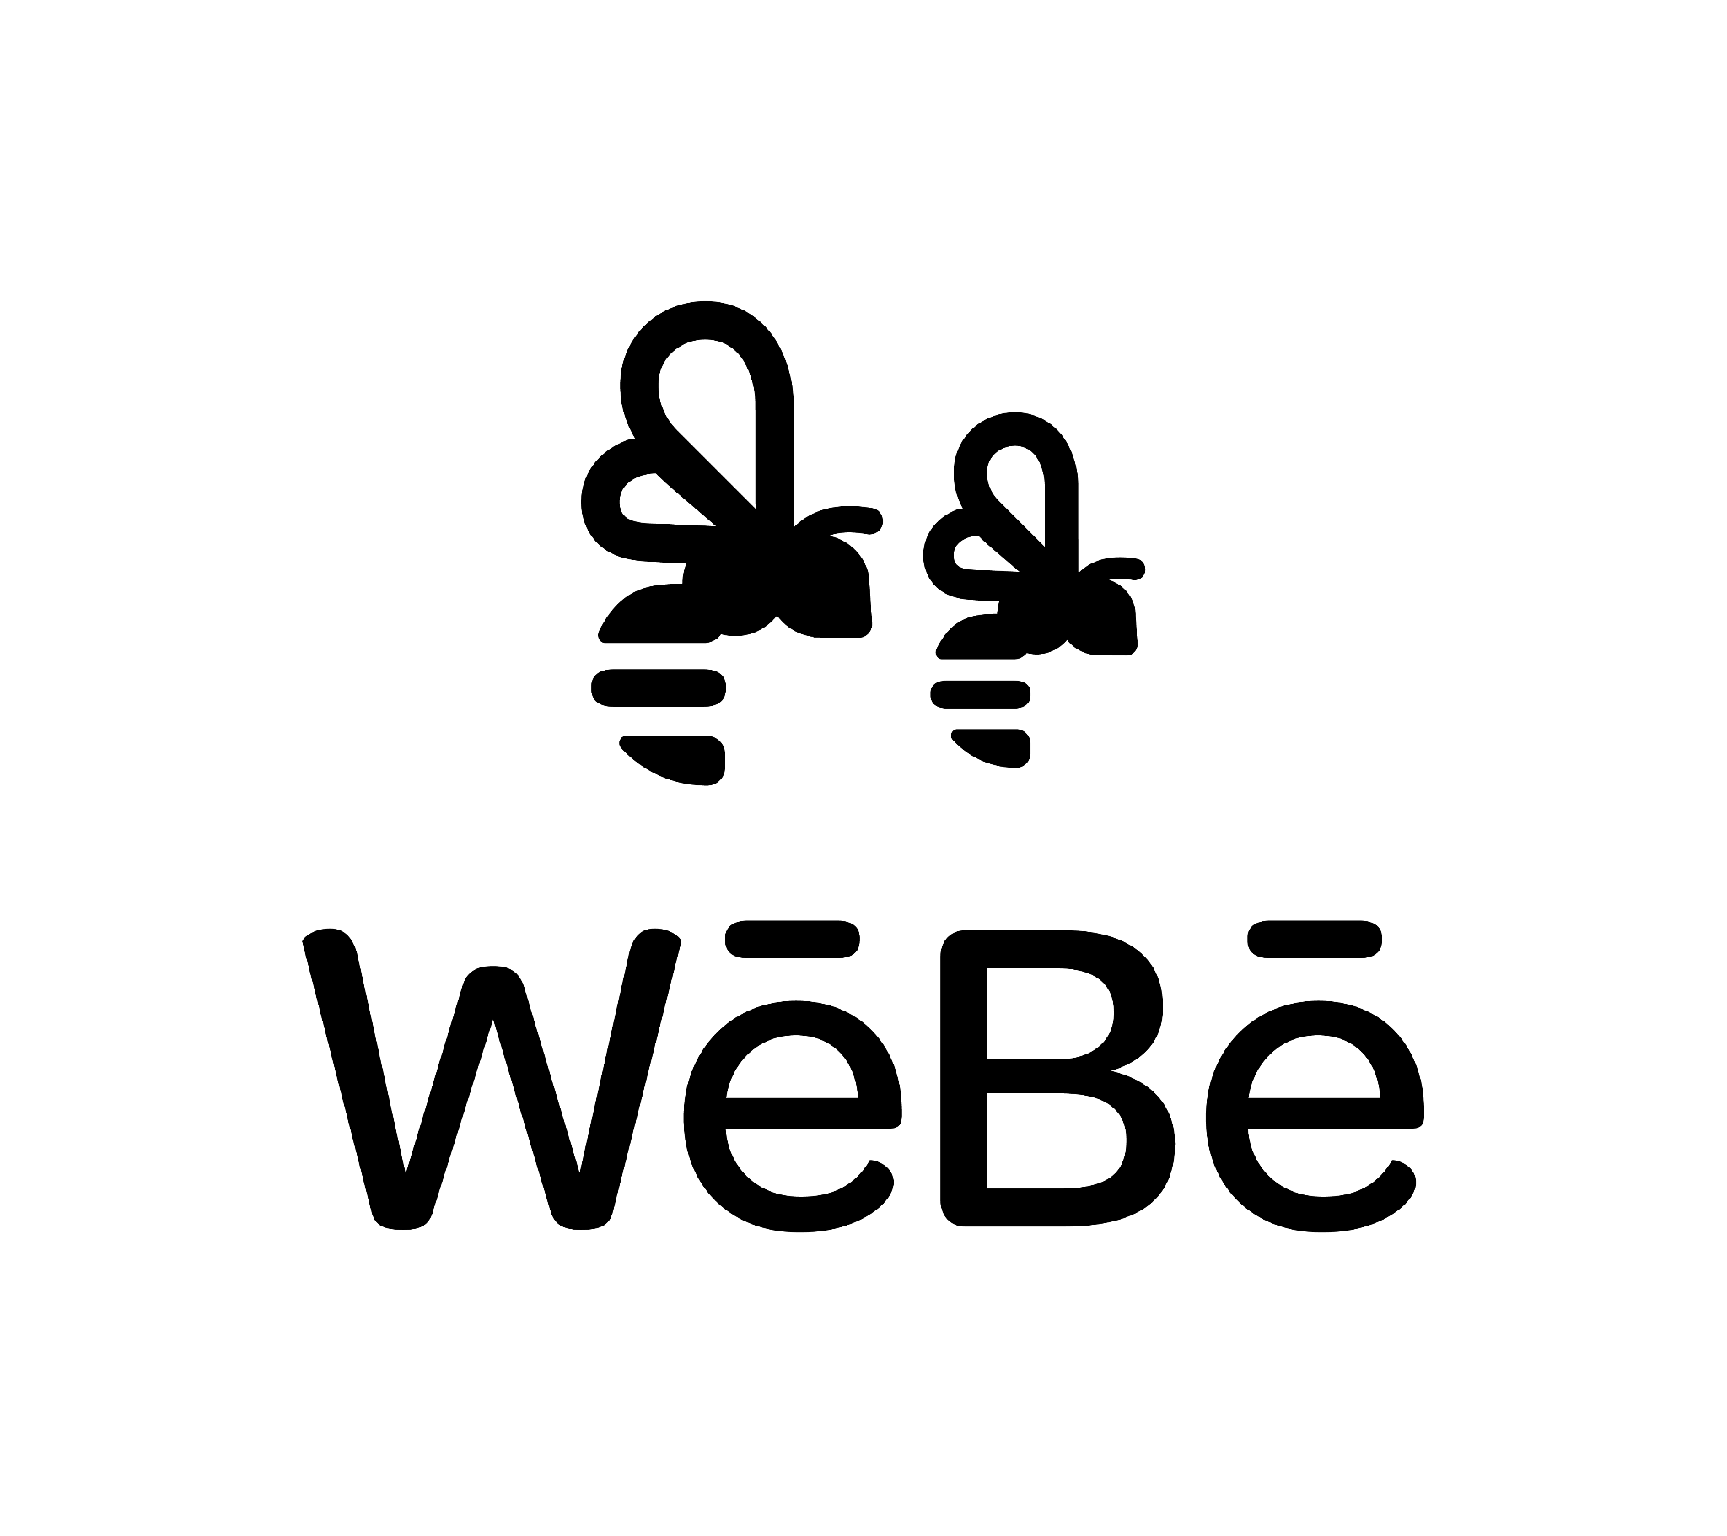
For more information contact:
Kirimatao Paipa: kirimatao.paipa@terauora.com
Dr Sarah Hayward: sarah.blyth.hayward@gmail.com

