Slide 1
Pacific peoples’ attitudes towards reopening the border and other aspects of the COVID-19 response
October 2021

Slide 2
1
2
4
Concern around Delta
KEY RESULTS
Support for mandatory tracer app use, and COVID-19 testing and vaccination is uniformly high
Personal impact of COVID-19
Nearly half of people feel the pandemic has had a positive impact on their overall wellbeing
Method:
Online survey of
301 18 years and over Pacific peoples
80 to 87% of people support mandatory COVID-19 tracer app use, and testing and vaccination of border workers, frontline workers, essential workers, and maritime and port workers
81%
of people are now more concerned about the pandemic than they were before the Delta variant emerged
Fieldwork:
5-13 October 2021
feel the pandemic has had a negative impact on their wellbeing
3
Reopening Aotearoa’s borders to the world
MOE:
Maximum margin of error of +/-5.7%
report experiencing negative emotions or challenging domestic situations nearly every day
5
Overall reactions to the COVID-19 strategy
have experienced verbal or physical abuse since the most recent lockdown
73%
definitely or somewhat think that the right decisions around reconnecting NZ are being made
84%
definitely or somewhat think those most at risk are being protected
63%
definitely or somewhat think the principles of Te Tiriti
are being upheld in the management of the pandemic
have been drinking more since the most recent lockdown

Slide 3

Background and objectives
The Ministry of Health are committed to improving Pacific peoples’ health outcomes and reducing health inequalities faced by Pacific peoples. In this context, the Ministry commissioned Kantar Public to help understand Pacific peoples reaction to border reopening, how the border reopening may impact behaviour, and attitudes towards mandatory vaccination and testing.
Methodology
TARGET AUDIENCE
INTERVIEW DATES
METHOD
SAMPLE SIZE AND MORE
WEIGHTING
Pacific people aged
18 and over.
5 to 13
October, 2021.
Online survey using Colmar Brunton’s consumer panel.
301 respondents. Maximum margin of error of +/-5.7%.
Results post-weighted by age, gender, age, and vaccination status.

Slide 4

Contents
1
The Delta variant and COVID-19 becoming endemic
5.
2
COVID-19 tracer app, mandatory testing, mandatory vaccination, and health behaviours
9.
3
Reopening New Zealand’s borders
14.
4
Phased border reopening plan
18.
5
Vaccination
26.
6
Impact of COVID-19 and the latest lockdown on wellbeing
30.
7
Overall reactions to the COVID-19 strategy
37.

Slide 5
The Delta variant and COVID-19 becoming endemic
1.

Slide 6
Eighty one percent of Pacific peoples are now more concerned about the pandemic than they were before the Delta variant emerged. Around half feel the more infectious strains put themselves, their family and their community more at risk. Those who are vaccinated have higher rates of concern.
Change in levels of concern since Delta emerged
81% more concerned
Vaccinated Nett more concerned
89%
(n=251)
Perceptions of increased risk
Q. Does the emergence of the Delta strain make you feel more or less concerned about the COVID-19 pandemic? Do you think the emergence of more infectious strains of COVID-19 put you more at risk?
Base: All Pacific peoples (n=301).

Slide 7

Peoples’ greatest concerns about COVID-19 becoming endemic in New Zealand are the health of themselves and others, as well as the possibility of ongoing lockdowns and restrictions. Six in ten are also concerned about the capacity of health system.
81% wellness of oneself and others
78% ongoing lockdowns and restrictions
Q. What would concern you about COVID-19, if we had to live with it in NZ (and could not eliminate it)?
Base: All Pacific peoples (n=301)

Slide 8
People over the age of 50, women, and those who are currently vaccinated tend to be more concerned than average about COVID-19 becoming endemic.
 | All Pacific peoples | Aged 50+ | Women | Vaccinated
 | (n=301) | (n=79) | (n=185) | (n=251)
NETT wellness of oneself and others | 81% | 90% | 83% | 87%
Illness / death of loved ones | 64% | 80% | 68% | 67%
Spreading COVID-19 to others | 57% | 74% | 65% | 64%
Illness / death | 52% | 68% | 59% | 55%
Ongoing effects of long COVID | 52% | 71% | 62% | 60%
NETT ongoing lockdowns and restrictions | 78% | 83% | 84% | 80%
Continuing lockdowns | 53% | 62% | 57% | 54%
Not being able to visit family / whānau / friends living outside New Zealand | 52% | 56% | 59% | 54%
Social isolation | 44% | 54% | 47% | 47%
Health system capacity | 61% | 82% | 67% | 67%
Financial stress | 53% | 65% | 60% | 55%
The economy | 47% | 61% | 52% | 51%
Something else | 2% | - | 3% | 2%
Nothing would concern me about COVID-19 becoming established in the community | 4% | 3% | 1% | 2%
Q. What would concern you about COVID-19, if we had to live with it in NZ (and could not eliminate it)?
Base: See chart for base sizes.

Slide 9
COVID-19 tracer app, mandatory testing, mandatory vaccination, and health behaviours
2.

Slide 10
Pacific peoples are generally very supportive of mandatory use of the COVID-19 tracing app.
Nett support
85% | 85% | 85% | 84% | 83% | 83% | 83% | 83% | 83% | 81% | 80%
Bars, restaurants, Kava clubs or other social venues | Hotels/motels | Supermarkets | Large retail premises | Public transport | Sports events/facilities | Public buildings | Smaller shops including butchers, bakeries, dairies | Taxis/Uber, Ola or Zoomy rides | Gyms | Office premises
Q. In your opinion, should the use of the COVID-19 tracing app / manual registration be compulsory to enter:
Base: All Pacific peoples (n=301)
Txt | txt significantly higher / lower than average.

Slide 11
Support is also strong for mandatory testing and vaccination for border workers, frontline workers, essential workers, and maritime and port workers.
Border workers |  | Frontline workers |  | Essential workers |  | Maritime / port workers
Nett support
87% | 83% |  | 86% | 83% |  | 84% | 81% |  | 83% | 80%
Q. Do you support or oppose mandatory COVID-19 testing for: Do you support or oppose mandatory COVID-19 vaccination for:
Base: All Pacific peoples (n=301).
Txt | txt significantly higher / lower than average.

Slide 12
Younger Pacific peoples (under 30), males, and those who are unvaccinated are less supportive than average of mandatory tracer app use, and mandatory COVID-19 testing and vaccination.
Mandatory use of the COVID tracer app
COVID Testing
Total | 18-29 | Men | Unvaccinated
Total | 18-29 | Men | Unvaccinated
Bars, restaurants, Kava clubs or other social venues
Hotels/motels
Supermarkets
Large retail premises
Public transport
Sports events/facilities
Public buildings
Smaller shops including butchers, bakeries, dairies
Taxis/Uber, Ola or Zoomy rides
Gyms
Office premises
Border workers
Maritime / port workers
Frontline workers
Essential workers
COVID Vaccination
Total | 18-29 | Men | Unvaccinated
Border workers
Maritime / port workers
Frontline workers
Essential workers
Q. In your opinion, should the use of the COVID-19 tracing app / manual registration be compulsory to enter: Do you support or oppose mandatory COVID-19 testing for: Do you support or oppose mandatory COVID-19 vaccination for:
Base: All Pacific peoples (n=301), 18-29 (n=77), men (n=115), unvaccinated (n=50).
Txt | txt significantly higher / lower than average.
12

Slide 13
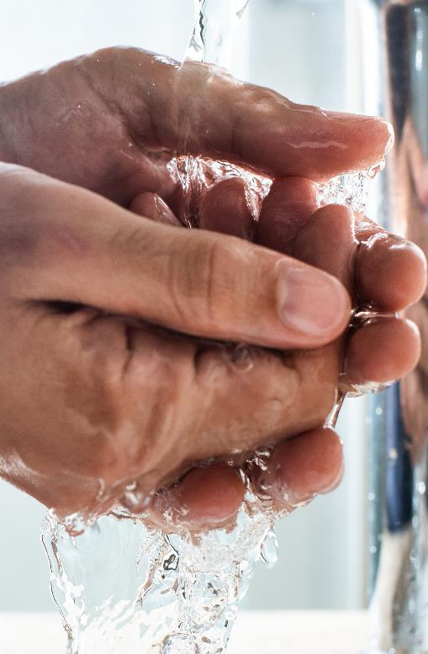
Before the most recent outbreak, 7 in 10 people were washing their hands with soap and water for 20 seconds, and 6 in 10 were coughing or sneezing into their elbow, staying home when unwell, and using the COVID-19 tracer app.
Aged 18-39 (n=177) | Men (n=115)
Handwashing with soap and water for 20 seconds
Coughing / sneezing into elbow
Staying at home when unwell
Using COVID Tracer App
Getting vaccinated
Avoiding large gatherings
Wearing masks around other people
Staying at least 2m away from people
Encouraging your family / whānau to get vaccinated
Avoiding social gatherings
Limiting movement and travel between regions of Aotearoa New Zealand
Avoiding public transport
Working from home
Limiting overseas travel
Getting a COVID-19 test if symptomatic
Manually signing into places outside the home
Getting a COVID-19 test if asymptomatic
Something else
I wasn’t doing any of these
Men and those under 40 were less likely than average to have practiced many of these public health behaviours.
Q. Which of these public health behaviours, if any, were you practicing before the previous lockdown (beginning on 17 August) to protect against COVID-19?
Base: All Pacific people (n=301).
Txt | txt significantly higher / lower than average.

Slide 14
Reopening New Zealand’s
borders
3.

Slide 15

Opinion on exactly when New Zealand should re-open its borders is mixed – however most think it should be before the end of 2022.
Immediately | By December 2021 | First half of 2022 | Second half of 2022 | 2023 | 2024 | 2025 | 2026 or later | Never | I'm really not sure
3% | 1% | 3% | 2%
4% | 22% | 26% | 19% | 5% |  |  |  |  | 14%
Q. In general, how quickly do you think Aotearoa New Zealand should re-open its borders to the world?
Base: All Pacific peoples (n=301)

Slide 16
When it comes time to open the borders, people believe the key things to consider are our ability and capacity to keep all New Zealanders safe and healthy, and ensuring high levels of vaccination. People who prefer the border be open before the end of this year are more likely than average to be concerned about personal freedom. Those who want the borders open in the first half of 2022 are more concerned about supporting jobs and businesses. Those who want the borders open in the second half of 2022 are concerned about health and the health system.
 | All Pacific peoples | Want the borders open by the end of the year | Want the borders open in the first half of 2022 | Want borders open in the second half of 2022
 | (n=301) | (n=69) | (n=76) | (n=65)
The ability to keep New Zealanders safe | 61% | 49% | 68% | 70%
The percentage of New Zealanders who have been vaccinated | 52% | 45% | 57% | 62%
The capacity and capability of the New Zealand health system | 51% | 40% | 57% | 56%
Reconnecting / re-uniting families | 50% | 48% | 58% | 49%
The ability to specifically keep New Zealand children safe | 50% | 29% | 56% | 56%
Allowing more New Zealand citizens and permanent residents to return | 47% | 49% | 56% | 44%
The capacity of the New Zealand contact tracing system | 40% | 23% | 41% | 60%
Jobs for New Zealanders | 39% | 33% | 54% | 36%
Allowing skilled workers to come to New Zealand | 37% | 38% | 53% | 31%
Maximising benefit to the economy | 35% | 42% | 46% | 22%
Allowing migrant workers to come to New Zealand to support our primary industries | 31% | 32% | 32% | 32%
Encouraging tourists back to New Zealand | 28% | 42% | 38% | 18%
Allowing overseas students at our universities and schools | 27% | 35% | 33% | 21%
Personal freedom | 27% | 46% | 24% | 22%
Maximising exports | 24% | 30% | 30% | 16%
Reducing dependence on imports | 20% | 16% | 28% | 20%
Allowing for sporting events | 18% | 31% | 18% | 17%
Facilitating business travel | 17% | 25% | 29% | 7%
Allowing immigration | 16% | 24% | 15% | 14%
People should be able to travel where they want to and when they want to | 15% | 26% | 17% | 14%
Something else | 2% | - | 2% | 11%
I don’t believe the borders should be opened | 8% | 3% | 4% | 10%
Q. Which of these things do you believe New Zealand should take into account in thinking about reopening its borders?
Base: See chart for base sizes.
Txt | txt significantly higher / lower than average.

Slide 17
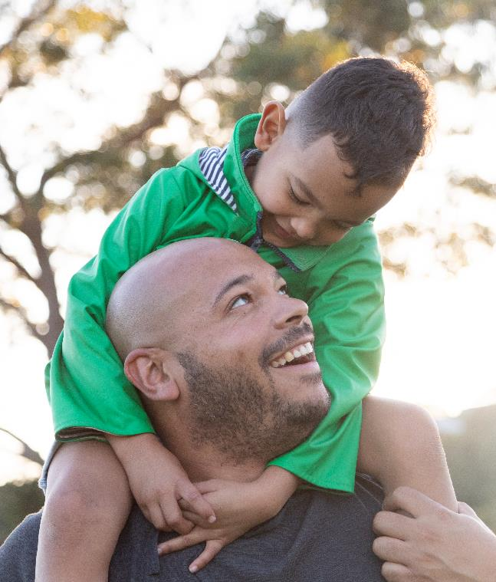
Most people prefer very high levels of vaccination to be achieved before reopening the borders.
Proportion of the population prefer to be vaccinated before reopening the borders
Q. What percentage of the total Aotearoa New Zealand population (including children under 12 years of age) would you prefer to be vaccinated before the borders are reopened?
Base: All Pacific peoples (n=301)

Slide 18
Phased border reopening plan
4.

Slide 19
Respondents were given a description of the phased border reopening plan and then asked their level of support. Two thirds indicated they support it. Those who are vaccinated tend to be more supportive than average.
All Pacific peoples
68% Nett support
 | VACCINATED | UNVACCINATED
 | (n=251) | (n=50)
Nett Support | 75% | 42%
Description provided to respondents:
The Government has announced that it will use the second half of 2021 to vaccinate as many New Zealanders as possible while it prepares and tests the safety of having three “Pathways” to allow people to enter Aotearoa New Zealand in 2022. This will involve allowing quarantine-free entry to vaccinated travellers from low-risk countries from early 2022 while those from medium- and high-risk countries will have to go through a combination of quarantine measures ranging from self-isolation to spending 14 days in quarantine. The phased reopening is looking to introduce:
A Low-Risk pathway allowing quarantine free entry for vaccinated travellers who have been in low-risk countries.
A Medium-Risk pathway allowing a combination of self-isolation and/or reduced time in managed isolation for vaccinated travellers who have been in medium-risk countries.
A High-Risk pathway continuing a full 14 days in managed isolation and testing for unvaccinated travellers and any traveller, including vaccinated travellers, who have been in high-risk countries.
Q. Overall, how strongly do you support or oppose this approach to a phased reopening?
Base: All Pacific peoples (n=301)
Txt | txt significantly higher / lower than average.

Slide 20
Those who support the phased reopening generally feel it’s a safe approach. Those opposed tend to focus on the risk it poses to New Zealanders.
Reasons for support
Reasons for opposition
It’s a safe approach
Want some normality back
It’s a good, fair and realistic approach
It enables family and friends to reunite
We can't stay isolated forever
Vaccinated people are safer / less of a problem
Good for the economy
Agree those coming from low risk countries should be treated differently to those coming from high risk countries
Need to have a plan / starting point
Makes sense
More freedom
Allows people to travel
Easiest way to maintain control
Enables NZers overseas to come home
Easy to adjust phases if needed
Controlled opening
COVID is here to stay
Increased risk
Early 2022 is too soon to open the borders
It's still not safe
People will flout the rules
Don't like the idea / doesn't feel right
Worried about the emergence of new strains
Need to get Covid under control / eliminated before we reopen
Should only let in people who are fully vaccinated
Should keep our borders closed as long as possible
Delta arrived from a low risk country
Don't trust international travellers
Will there be enough checks / testing?
Not everyone is vaccinated yet
Can still spread the virus even when vaccinated
Hospitals are already under resourced
How will we keep New Zealanders safe?
Keep strict protocols in place for quarantine
No faith in current decision making
Support some of the phases but not the high risk phase
Should open without phases
Q. Why do you support the phased opening? Why don’t you support the phased opening?
Base: Those who support the phased reopening (n=214), those who oppose the phased reopening (n=63).
Note: Responses less than 3% not shown in charts.

Slide 21
Below are a selection of comments people made when asked why they support or oppose the phased reopening.
Reasons for support
Reasons for opposition
“There are so many Kiwis stuck overseas who want and need to come home and it should be easier for them to do so. I miss my whānau and friends who are overseas so I want to be able to see them as soon as possible. As someone who loves to travel and experience new cultures it is difficult to watch people in other countries be able to enjoy the freedoms of travel purely because they are fully vaccinated, just as I am. I understand that our country does not have the best systems in place to be able to cope with a surge of Covid-19. I also want to keep my community safe so I have been doing my bit by following all of the govt's guidelines. I just really want to move towards reconnecting with the world as soon as it is safe to do so. I love Aotearoa New Zealand but feel as though being fully vaccinated should provide pathways to travel that are not there yet. I would happily self-isolate at home upon my return for the full 2 weeks if it meant reconnecting with loved ones overseas.”
“It's better to open things slowly rather than all at once to give an indication of the rapid spread of the delta variant. It's a smart move from cabinet to do this. If we were to enter level 2 and almost everything opening up at once, it would be chaotic and our cases would be increasing rather decreasing. I also believe that the phases give people more incentive to get vaccinated to enjoy what is going to open. However, if we stay in level 3 with hardly anything open to support the economy, it will turn out to be Level Free. I strongly support phased opening!”
“To allow as long as possible to get people vaccinated, in particular vulnerable groups such as Māori, Pasifika and the elderly. Plus I’d like to see 5-11 year olds added to the rollout.”
“The boarders were completely shut and then we opened to a low risk country and ended up with covid back in the community and after an even longer level 4 lockdown than 2020 still have not been able to reduce the numbers. Opening up to more countries increases the chances of covid spreading like wildfire.”
“Because we are opening up our own country to places that are worse off, I believe that sorting out our own country is the best thing we can do at this stage before opening it up to the rest of the world. I do know that at some stage we need to but until we are under control I do not think this should be an option especially when many are still experiencing Level 3 lockdown.”
“Potential risk of getting in a new mutation into the country that the vaccine may not be affective on. Also the vaccine does not eliminate infection so compromised individuals with commodities and immune compromise can still end up really sick and in need of specialized health care which is crucially understaffed and underpaid.”
“Concerned about the safety of my whānau and community.”
Q. Why do you support the phased opening? Why don’t you support the phased opening?
Base: Those who support the phased reopening (n=214), those who oppose the phased reopening (n=63).

Slide 22
When looking at specific aspects of the proposal, people are most supportive of using MIQ facilities for travellers from high-risk countries and unvaccinated travellers.
Nett support
73% |  | 72% |  | 63% |  | 59% |  | 54%
14 days in MIQ for vaccinated travellers who have been in high risk or very high-risk countries | 14 days in MIQ for all unvaccinated travellers | Quarantine-free travel being introduced for vaccinated travellers who have been in low-risk countries | Self-isolation arrangements for some vaccinated New Zealanders who have been in medium-risk countries | The plan to change to an individual, risk-based approach
Q. Assuming the plan was to proceed, how strongly do you support or oppose:
Base: All Pacific peoples (n=301)

Slide 23
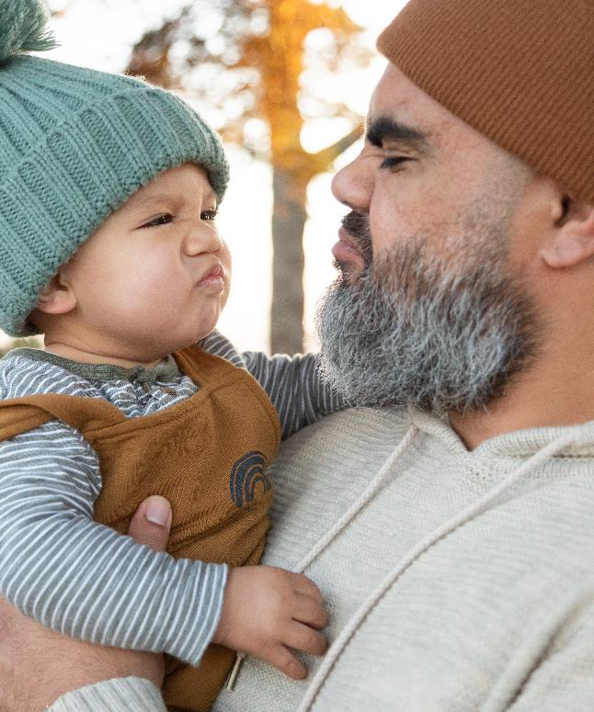
Where isolation is required half the sample feel it should be done in MIQ. A quarter feel it would be sufficient for it to be done at home.
Government managed facilities (MIQs)
At home
Another sort of government-managed facility
Accommodation managed by iwi / community provider
Somewhere else
Q. If isolation is required, do you think people returning to New Zealand should isolate in:
Base: All Pacific peoples (n=301)

Slide 24
Sixty-one percent of people feel two doses of the vaccine is enough to enable safe reopening of the borders. A quarter disagree.
Demographic differences
61%
Nett Yes
All Pacific peoples |  | Men | Women | Vaccinated | Unvaccinated
26%
Nett No
(n=301) |  | (n=115) | (n=185) | (n=251) | (n=50)
Q. Do you think having two doses of the COVID-19 vaccine is enough to make it safe to open the border to more countries for quarantine-free travel?
Base: All Pacific peoples (n=301)

Slide 25
When New Zealand’s borders open to the world Pacific peoples believe they are likely to be more vigilant in practicing public health behaviours. Especially so when we start admitting people from high-risk countries.
Avoiding large gatherings | Avoiding social gatherings | Avoiding public transport | Working from home | Staying at least 2m away from people | Limiting your movement and travel between regions in New Zealand | Limiting overseas travel | None of these
Q. Which of these public health behaviours, if any, were you practicing before the previous lockdown (beginning on 17 August) to protect against COVID-19? Realistically, what public health behaviours would you practice if New Zealand's border were open to:
Base: All Pacific peoples (n=301)

Slide 26
Vaccination
5.

Slide 27
Of those who are not yet vaccinated, nearly half say they are likely to do so. One in five are unsure what they will do. When deciding whether or not to be vaccinated around half say they plan to make the decision autonomously, while more than a quarter will decide as a family unit.
Likelihood of getting vaccinated (among unvaccinated)
44% Nett Likely
Vaccination decision makers
52%
28%
6%
14%
1%
Decide individually
Decide together as a family
Other
Don’t
know
Not
applicable
Q. Will you get the COVID-19 vaccine? How will you and your family decide to get vaccinated or not?
Base: Those who are unvaccinated (n=50)

Slide 28
Protecting those closest to them is the biggest vaccination motivator for both all Pacific peoples and the unvaccinated. For the unvaccinated, getting back to normal is a much more important motivator than for all people.
All Pacific peoples
Unvaccinated
Taking care of my family / whānau and those closest to me
Doing the best thing for my own health
Helping to protect all New Zealanders
Helping to end the COVID-19 pandemic more quickly
Helping reduce the risk of COVID-19 infection / further lockdowns and economic harm
Getting 'back to normal'
Slowing the spread of COVID-19
If there were consequences for not practicing protective behaviours
Helping me to travel internationally again
Taking care of my local community / church community
Taking care of my hapū / iwi
Something else
None of these
Q. Which of these, if any, would motivate you to behave in ways which protect you or others from COVID-19?
Base: All Pacific peoples (n=301), unvaccinated (n=50).
Txt | txt significantly higher / lower than average.

Slide 29
Three quarters of people say they are likely to participate in annual booster vaccinations. Those under 40, those who are unemployed, and those who are currently unvaccinated are least likely to get annual boosters.
Likelihood of getting booster vaccines
Demographic differences
75%
Nett Likely
All Pacific peoples | 18-39 | Unemployed | Unvaccinated
(n=301) | (n=177) | (n=69) | (n=50)
Q. If annual 'booster shots' of a COVID-19 vaccine were recommended to continue protection in the future, how likely would you be to get one each year?
Base: All Pacific peoples (n=301)
Txt | txt significantly higher / lower than average.

Slide 30
Impact of COVID-19 and the latest lockdown on wellbeing
6.

Slide 31
Just as many people say the COVID-19 pandemic has had a positive impact on their personal wellbeing as say it has had a negative impact.
All Pacific peoples |  | 18 to 29 | 30 to 39 | 40 to 59 | 60 plus |  | Men | Women |  | Employed | Unemployed |  | Vaccinated | Unvaccinated
Nett positive
impact
48% |  | 52% | 42% | 43% | 60% |  | 52% | 44% |  | 53% | 34% |  | 51% | 38%
Nett negative
52% |  | 48% | 58% | 57% | 40% |  | 48% | 56% |  | 47% | 66% |  | 49% | 62%
Base
(n=266) |  | (n=67) | (n=86) | (n=80) | (n=33) |  | (n=110) | (n=155) |  | (n=205) | (n=61) |  | (n=224) | (n=42)
Very positive | Somewhat positive | Somewhat negative | Very negative
Q. Would you say that the COVID-19 pandemic has had a positive or negative impact on your personal wellbeing?
Base: See chart for base sizes (excludes Don’t know).
Txt | txt significantly higher / lower than average.

Slide 32
Many of those who have had a positive experience attribute it to being able to spend quality time with family, while others appreciate the feelings of safety evoked by New Zealand's approach. Those who have had a negative experience say they feel this way because of the restrictions limiting their ability to see family and feelings of deteriorated mental health.
Reasons behind positive experiences
Reasons behind negative experiences
Spending quality time with family / children
Its keeping us safe / safe at home
All good
Made me focus on my own health and wellbeing and what's important
It's been a good way to reset / have a break
Ability to work from home
Government is doing the right thing / lockdown is the right approach
Saved money
Safer in NZ than elsewhere
Still able to work / essential worker
Don't know / no comment
Can’t see / visit family
Adversely affected my / my family's mental health
Stress
Isolation
Anxiety
Can't travel
Financial stress
Lack of social life
Had to work during lockdown
Lockdowns and restrictions
It’s changed my normal routine / lifestyle
Depression
Tired / mentally drained
Uncertainty about income / work
Sick of the complaining / false information / journalism
Unable to attend a funeral
Difficulties with online learning
Hard to juggle everything
Stuck at home
Stuck at home with children
Had to wait for medical care
Frustrating / difficult time
Worried about shopping
Wellbeing negatively affected
Don't know
Q. Why do you say that?
Base: Those who have had a positive experience (n=126), those who have had a negative experience (n=140).
Note: Responses less than 3% not shown in charts.

Slide 33
Below are a selection of comments people left when asked for the reasons behind their positive or negative lockdown experiences.
Reasons behind positive experiences
Reasons behind negative experiences
“Routine work home life has lead to a shortage of family time. Lockdown gave us heaps of what we were missing.”
“The lockdown has given me the opportunity to reflect on life and appreciate what I have. I have managed to get things done that I wouldn't have otherwise been able to do. I have learned to communicate and connect with people using technology like zoom and other application that I would not have had time to learn during the normal scheme of things. There are a lot of positive things that came out of lockdown so I have no complaints.”
“Save money, have peace of mind, do things in the comfort of home, see the world get a chance to heal itself, get to experience wildlife interaction with nature.”
“Bought whānau / iwi together.”
“We finally have a government who cares about us personally and not just about the economy.”
“It’s hard when some of us (of the team of 5 million) are actually doing everything in the best of our ability to follow the rules and everything, just for others to ruin that effort. I live away from home for university, and I honestly struggle with the constant changes in alert levels and the lockdowns. You're separated from your family and you just struggle alone. There are many times, I feel like I am given false hope with borders re-opening so I can see family again, but then again new cases arises and it is just mentally draining.”
“Lockdowns are mentally draining, the financial impact is huge, the emotional impact is huge, coping with it as an adult is hard but supporting children to cope with it is even harder and the mortality and hospitalisation statistics don't warrant lockdowns.”
“I feel that racism and prejudice really took a hold once Covid-19 hit. Lots of double standards came out e.g. a brown family was at the heart of the August 2020 lockdown and EVERYONE in South Auckland took bullets. A man from the shore was the first Delta case for this lockdown and no bullets went that way, but as soon as the AOG church in Mangere was named, more bullets came flying. I thought it would be safe to raise our kids here but I don't think it is. Covid is nothing compared to people's prejudices.”
Q. Why do you say that?
Base: Those who have had a positive experience (n=126), those who have had a negative experience (n=140).
Note: Responses less than 3% not shown in charts.

Slide 34
In the last two weeks, nearly one in five people report experiencing negative emotions or challenging domestic situations nearly every day.
Total level
Specifically affected by…
Affected nearly every day
Not at all affected
Affected several days / more than half the days
Q. Over the last 2 weeks, how often have you been bothered by the following problems?
Base: All Pacific peoples (n=301).

Slide 35
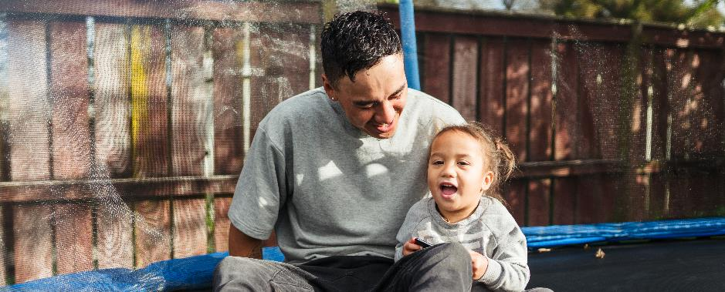
Nearly a third of people have experienced some form of verbal or physical abuse since the most recent lockdown came into effect. Men and those under 30 are most likely to report having experienced some form of verbal or physical abuse.
Have experienced verbal or physical abuse (since the most recent lockdown began)
Have NOT experienced any verbal or physical abuse
More than usual in the home
The same as usual in the home
Not in the home
More than usual outside the home
The same as usual outside the home
Not outside the home
Demographic differences
22% NETT the same / more than usual inside the home
Base
(n=301) |  | (n=77) | (n=115)
27% NETT the same / more than usual outside the home
Q. Since the start of the most recent nationwide lockdown on 17 August, have you experienced any verbally or physically abusive situations:
Base: All Pacific peoples (n=301).
Txt | txt significantly higher / lower than average.

Slide 36
Around one in six people say they are drinking more alcohol now than they were before the start of the most recent lockdown. Nearly than one in four are concerned about the drinking of someone else in their household.
Alcohol consumption since most recent lockdown
Drivers of increased alcohol consumption
Spending more time at home
Boredom / nothing else to do
Increased anxiety
Increased stress
Purchase more alcohol than usual
Worried about COVID-19 / the future
Been drinking alcohol daily
Enjoy drinking more
Been drinking alcohol alone more often
Been drinking alcohol earlier in the day
Dependent on alcohol
Not sure
I’ve been drinking more | I’ve been drinking about the same amount | I’ve been drinking less | I don’t drink alcohol | I’m not sure
Concern over another household member’s drinking
71% Nett No
23% Nett Yes
Definitely | Somewhat | Somewhat no | Definitely no | I'm not sure
Base (n=48)
Q. Since the beginning of the most recent lockdown (17 Aug.), are you drinking more or less alcohol? Why do you think your consumption of alcohol has increased? In confidence, are you concerned with the amount of alcohol someone else in your household is drinking?
Base: All Pacific peoples (n=301).

Slide 37
Overall reactions to the COVID-19 strategy
7.

Slide 38
People generally feel the right decisions are being made when it comes to: reconnecting Aotearoa to the world, protecting those most at-risk, and upholding Te Tiriti o Waitangi.
Making the right decisions around reconnecting Aotearoa to the world
Protecting those most at-risk
Upholding Te Tiriti o Waitangi
73%
somewhat or definitely
agree
84%
somewhat or definitely
agree
63%
somewhat or definitely
agree
Q. Overall, do you think the government is making the right decisions as we seek to reconnect Aotearoa New Zealand to the world? Do you think the government has protected the health of the people most at-risk from COVID-19 in the past year? Do you think the government has upheld the principles of Te Tiriti o Waitangi in the way it has managed COVID-19?
Base: All Pacific peoples (n=301).

