Slide 1
Preventing and Minimising Gambling Harm 2022/23 to 2024/25
Consultation on:
Proposed Strategic Plan and Service Plan
and Problem Gambling Levy

Slide 2
Outline of Presentation
Context – the Gambling Act requirements
Gambling harm needs assessment
Consultation Document
Draft Strategic Plan 2022/23 to 2024/25
Draft Service Plan and indicative costs 2022/23 to 2024/25
Draft problem gambling levy rates and options 2022/23 to 2024/25

Slide 3
Context

Slide 4
Context – what is gambling harm?
The Gambling Act 2003 defines gambling harm as:
‘Harm or distress of any kind arising from, or caused or exacerbated by, a person’s gambling; and
Including personal, social, or economic harm suffered –
By the person; or
By the person’s spouse, civil union partner, de facto partner, family, whānau, or wider community; or
In the workplace; or
By society at large.’

Slide 5
What is the Strategy?
The Gambling Act 2003 requires an ‘integrated problem gambling strategy focused on public health’ which must include
Measures to promote public health
Services to treat and assist problem gamblers and their families/whānau
Independent scientific research
Evaluation.

Slide 6
Gambling Harm Needs Assessment 2021
Most people gamble for leisure and recreation
There are widespread risks of gambling harm. All forms of gambling are widely available in New Zealand. Online gambling for money has increased
Māori, Pacific, Asian and young people/rangatahi are at greatest risk, or continue to experience the greatest levels of gambling harm
The total number of people affected by gambling harm has increased in line with population growth
Gambling expenditure decreased during COVID-19 lockdowns but returned to pre-COVID levels shortly after lockdown lifted
Service uptake has been well below expected demand.
There are silos between gambling services and mental health and addiction services.

Slide 7
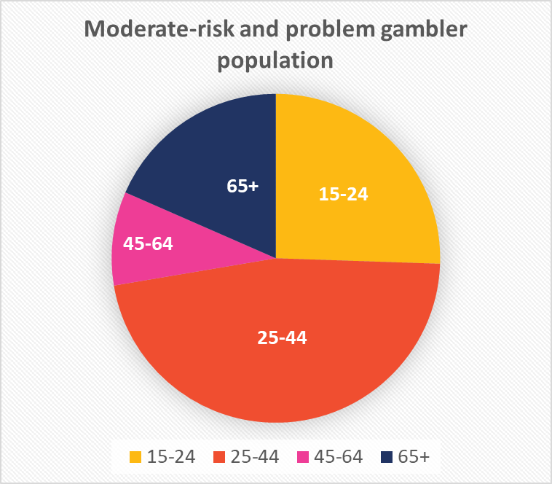
Gambling and Young people / Rangatahi
Young people aged 15–24 years make up approx. 27 percent (21,000 people) of the total proportion of moderate and high-risk gamblers (1.9 percent of all adults or 76,000 people).
While there was a decrease in youth gambling from 2016 to 2018, this decrease follows more than a decade of increasing or static prevalence rates, and it is not yet clear if this represents a trend
Health & Lifestyles Survey 2018

Slide 8
Use of gambling harm services 2019/20
 | Family/Affected Other |  | Gambler |  | Grand Total
<18 | 81 | 2% | 24 | 0% | 105 | 1%
18-24 | 346 | 9% | 421 | 8% | 767 | 8%
25-34 | 951 | 24% | 1550 | 28% | 2501 | 26%
35-44 | 952 | 24% | 1429 | 26% | 2381 | 25%
45-54 | 757 | 19% | 1060 | 19% | 1817 | 19%
55-64 | 562 | 14% | 700 | 13% | 1262 | 13%
65-74 | 233 | 6% | 299 | 5% | 532 | 6%
75+ | 70 | 2% | 67 | 1% | 137 | 1%
Grand Total | 3952 | 100% | 5550 | 100% | 9502 | 100%

Slide 9
Online gambling
13% New Zealanders gamble online locally 2% offshore (HLS 2018)
Access to online gambling for money has increased
Levels increased during 2020 lockdown and remained
Research shows online gambling can increase young people’s vulnerability to gambling harm
In 2020/21 of the 4701 people seeking clinical help (excluding brief interventions):
779 (17%) indicated that they had experienced harm from overseas/offshore gambling
121 (3%) indicated that they had experienced harm from online gambling within NZ

Slide 10
Gaming/gambling
Research has identified specific harms from some kinds of gambling to children and young people.
Findings from research examining link between video games and Pacific youth gambling suggest parallels between gaming and gambling.
2021 needs assessment highlighted increasing numbers of parents asking for support for young people who were ‘addicted’ to gaming.

Slide 11
Needs assessment key recommendations
Position the strategy within an overarching equity framework and address inequities
Increase opportunities for workforce development and cultural safety
Provide for more holistic and integrated services and supports.
Ensure clear public health messaging aligned with different cultural world views
Take action to reduce the stigma attached to gambling and gambling harm,
Continue to develop and test innovative service and support models
Continue to use research and evidence to inform our approach
Conclusion: strengthen support for priority populations young people / rangatahi

Slide 12
The Strategic plan

Slide 13
The strategic plan
Describes our goals and outcomes – what we want to achieve
Sets out priority areas and actions that we will focus on over the next three years
Includes stronger focus on equity and promoting health and wellbeing to address persistent inequities

Slide 14
Revised strategic framework
The new strategic framework consists of:
a population outcome: Pae Ora – Healthy Futures
a strategic goal: Promoting equity and wellbeing by preventing and reducing gambling-related harm.
priority action areas aligned to key outcomes and objectives
Aligned with the public health approaches in
Whakamaua: Māori Health Action Plan 2020-2025
Kia Kaha, Kia Māia, Kia Ora Aotearoa: COVID 19 Psychosocial and Mental Wellbeing Plan.

Slide 15
Revised strategic objectives
Objective One: Create a full spectrum of services and supports
Objective Two: Shift cultural and social norms
Objective Three: Strengthen leadership and accountability to achieve equity
Objective Four: Strengthen the health and health equity of Māori, Pacific, Asian, and rangatahi
These proposed objectives align with those in the current strategy (Appendix 4)

Slide 16
The Service Plan

Slide 17
Young people/rangatahi
The service plan proposes to prioritise young people / rangatahi to:
improve their awareness of the risks and signs of gambling harm, how to seek help and making positive behaviour and lifestyle changes
enable supportive conversations and challenge stigma;
ensure services are designed collaboratively and inclusively, using co-design and lived experience
research barriers to equitable service access and outcomes
It also proposes to prioritise investment to support young people/rangatahi entering the gambling-harm workforce, including scholarships

Slide 18
Proposed additional investment
New initiatives
a de-stigmatisation initiative focused on priority populations
Scholarships for priority groups to enter the gambling harm workforce
Developing a NZQA level 7 qualification covering gambling harm
Continue to develop innovative service models:
Continue and progress the new service and innovation pilots to enable accessible and equitable services and supports
Expand gambling harm peer workforce
Increasing the full-time equivalent (FTE) rate for gambling harm clinical intervention services.
Dedicated funding for Multi-venue Exclusion (MVE) Administration Service and database.

Slide 19
Continued service investment
Public health services
Public health services to empower people and communities
Health and education promotion programme
Gambling Harm Lived Experience Advisory Group
National Coordination Service, public health workforce development and conference support
Clinical intervention services
Helpline and web-based services
Workforce development, including cultural competency
Data collection and reporting

Slide 20
Continue service and innovation pilots with funding for next steps
Pilots to addressing inequities for Māori and Pacific peoples and those living in isolated areas
Develop and test innovative uses of technology to address gambling harm
Increased investment to pilot and expand gambling harm peer workforce
Pilot and implement a clinically robust model of care based on intensive treatment for people experiencing severe gambling harm.

Slide 21
Research and evaluation
Decreased investment:
Reduction from $6.629 million to $3.832 million over 3 years (a reduction of $2.797 million)
Research and evaluation strengthens the evidence base that supports all our work to prevent and minimise gambling harm
Proposed research priorities include:
prevalence data, longitudinal studies, gambling harm needs assessment
addressing cultural barriers to equitable service access, including young people/rangatahi
preventing and minimising harm from online gambling
assessing the relationship between gaming and gambling

Slide 22
Indicative budget to prevent and minimise gambling harm (GST exclusive) 2022/23 to 2024/25
Service area | 2022/23 ($m) | 2023/24 ($m) | 2024/25 ($m) | Total ($m)
Public health services (harm prevention and minimisation) | 7.168 | 7.490 | 7.482 | 22.140
Clinical intervention and support services | 10.571 | 10.571 | 10.897 | 32.039
Research and evaluation | 1.079 | 1.383 | 1.370 | 3.832
New services, innovation pilots and investments | 2.477 | 2.257 | 1.691 | 6.426
Ministry operating costs | 0.957 | 0.990 | 0.990 | 2.937
Total ($m) GST Exclusive | 22.252 | 22.691 | 22.430 | 67.374

Slide 23
The problem gambling levy

Slide 24
What is the problem gambling levy for?
The problem gambling levy recovers the cost of the Ministry-funded services to prevent and minimise gambling harm and of the Ministry’s costs for implementing and managing those services.
The Act prescribes a levy formula which takes into account:
forecast and actual expenditure over time
any over or underpayments by each sector
changes in each sector’s share of expenditure and presentations (as two proxy indicators of harm).

Slide 25
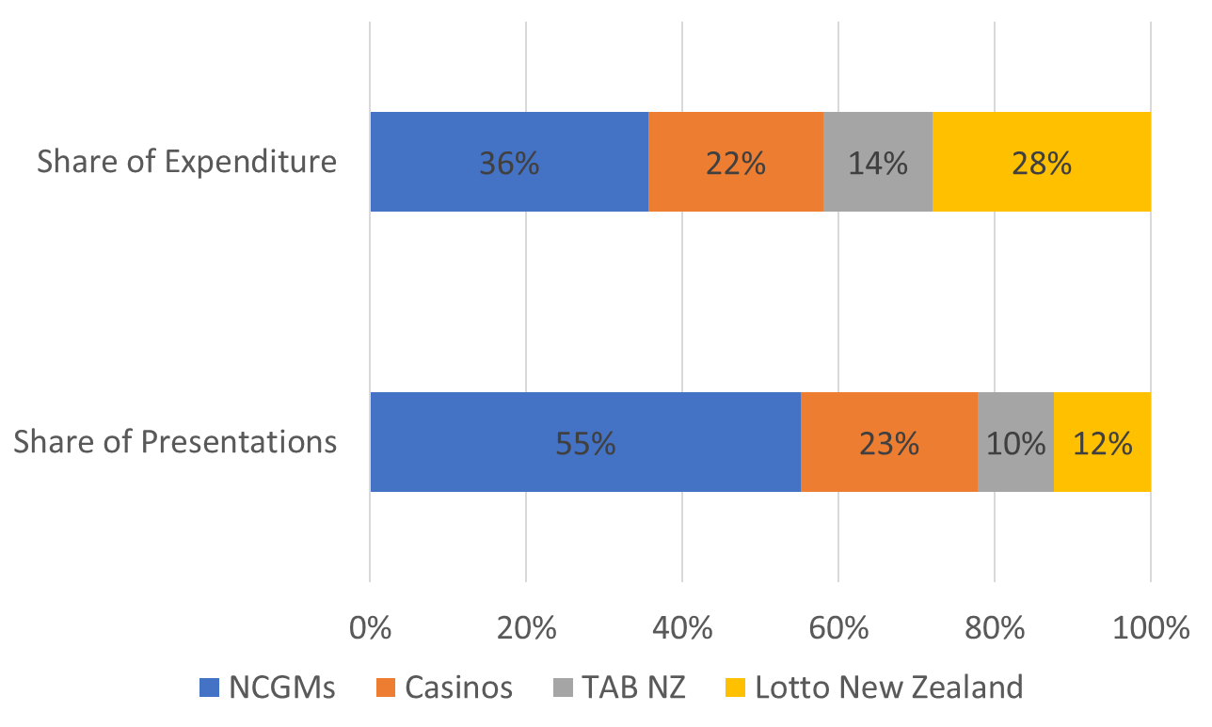
Share of presentations and expenditure by sector, for 2020

Slide 26
Expected levy payment ($m) per sector by expenditure/presentation weighting options
Presentation weighting % | NCGM | Casino | TAB NZ | Lotto NZ
30/70 current levy | 22.967 | 11.213 | 6.176 | 7.906
95 (Option 1) | 33.405 | 15.316 | 7.018 | 7.370
90 (Option 2) | 32.762 | 15.316 | 7.128 | 8.084
80 (Option 3) | 31.478 | 15.316 | 7.457 | 9.035
70 (Option 4) | 30.193 | 15.316 | 7.786 | 9.986
Notes:
.

Slide 27
Making a submission
The submissions form includes series of questions
Written submissions: Please include a copy of the submission form at the back of the consultation document.
Must be received by Friday 8 October (after that = not in analysis)
Prefer electronic copy:
Online complete the online submission form available on the Ministry's consultation hub
Email to gamblingharm@health.govt.nz either the submission form as Word document, pdf or short email
For hard copy post to (allow time for it to be received by close-off date)
Preventing and Minimising Gambling Harm Submissions
Mental Health and Addictions
Ministry of Health
PO Box 5013
WELLINGTON 6145.

Slide 28
Next steps
Submissions close 8 October 2021
Analysis of submissions and possible revision of draft Strategy
Updated levy calculations
Late November revised Proposals Document to Ministers & Gambling Commission
January 2022 Gambling Commission meeting and report
March 2022 Cabinet decisions on shape of strategy and levy
Late May 2022 (approximately) strategy and levy made public
1 July 2022 start of new strategy and levy
https://www.health.govt.nz/publication/draft-strategy-prevent-and-minimise-gambling-harm-2022-23-2024-25

Slide 29
Thank you
Questions & points for clarification?

