Slide 1
Preventing and Minimising Gambling Harm
2022/23 to 2024/25
Consultation on:
Proposed Strategic Plan and Service Plan
Proposed Levy Rates
Ministry's Consultation Hub.
https://www.health.govt.nz/publication/draft-strategy-prevent-and-minimise-gambling-harm-2022-23-2024-25

Slide 2
Outline of Presentation
  Context – the Gambling Act requirements
  Gambling harm needs assessment
  Consultation Document
    Draft Strategic Plan 2022/23 to 2024/25 – what we want to achieve
    Draft Service Plan and indicative costs 2022/23 to 2024/25 – how we plan to do it and the services we will provide and costs
    Draft problem gambling levy rates and options 2022/23 to 2024/25 – how we will fund these activities.
  How to make a submission
  Next steps
  Questions / points for clarification.

Slide 3
Context

Slide 4
Context – what is gambling harm?
The Gambling Act 2003 defines gambling harm as:
  ‘Harm or distress of any kind arising from, or caused or exacerbated by, a person’s gambling; and
  Including personal, social, or economic harm suffered –
    By the person; or
    By the person’s spouse, civil union partner, de facto partner, family, whānau, or wider community; or
    In the workplace; or
    By society at large.’

Slide 5
Context – what is the Strategy?
The Gambling Act 2003 requires an ‘integrated problem gambling strategy focused on public health’ which must include
  Measures to promote public health
  Services to treat and assist problem gamblers and their families/whānau
  Independent scientific research
  Evaluation.
  The Ministry of Health is responsible for developing the strategy every three years, and for implementing it.
  The Crown recovers the cost of developing and implementing the strategy using a ‘problem gambling levy’.
  The process for this consultation is set out in the Act, and includes carrying out a Needs Assessment.

Slide 6
Health and Disability System Reforms
The Government has confirmed the details of the health system reforms in response to Health and Disability System Review/Hauora Manaaki Ki Aotearoa Whānui
The Ministry is working with DPMC who are leading the response to the Health and Disability System Review
We have drafted the Strategy based on what we know right now, which is the current system
We will incorporate information about the new health system, and how it relates to preventing and minimising gambling harm, as it becomes available.

Slide 7
Gambling Harm Needs Assessment 2021
The Ministry commissioned Malatest International to:
  Identify changes in the evidence since the 2018 Needs Assessment
  Identify gaps in service delivery.
  Summarise the Ministry’s progress across the 11 Objectives set out in the current Strategy 2019/20-2021/22.
Methods included:
  Literature review
  Interviews and focus groups
  Online surveys (workforce and consumer)

Slide 8
Needs assessment key findings
Most people gamble for leisure and recreation
There are widespread risks of gambling harm. All forms of gambling are widely available in New Zealand. Online gambling for money has increased
Māori, Pacific, Asian and young people/rangatahi are at greatest risk, or continue to experience the greatest levels of gambling harm
The total number of people affected by gambling harm has increased in line with population growth
Gambling expenditure decreased during COVID-19 lockdowns but returned to pre-COVID levels shortly after lockdown lifted
Service uptake has been well below expected demand.
There are silos between gambling services and mental health and addiction services.

Slide 9
Gambling Harm Prevalence
Research shows that Māori and Pacific peoples, some Asian communities and young people / rangatahi disproportionately experience gambling harm.
Māori were four times more likely to be moderate risk and problem gamblers compared with non-Māori.
Pacific peoples were about 1.6 times more likely to be moderate-risk and problem gamblers compared with non-Pacific peoples.
Asian adults were less likely to gamble overall, but those who did were much more likely to experience harm compared to European/Other.
Young people aged 15–24 years made up approximately 27 percent (21,000 people) of the total proportion of moderate-risk and harmful gamblers (1.9 percent of all adults or 76,000 people).

Slide 10
Māori: gambling harm prevalence
Māori report the greatest levels of gambling prevalence and gambling harms compared with non-Māori
Māori are four times more likely to be moderate risk and problem gamblers compared with non-Māori. (HLS 2018)
About 5.9% were moderate-risk / problem gamblers, and 4.5% were low-risk gamblers. (HLS 2018)
Māori made up just over 30% of those who accessed clinical services in 2019/20 to address harm from gambling
  Māori made up 27% of those who sought help with their own gambling
  Māori made up 38% of family affected others who sought help

Slide 11
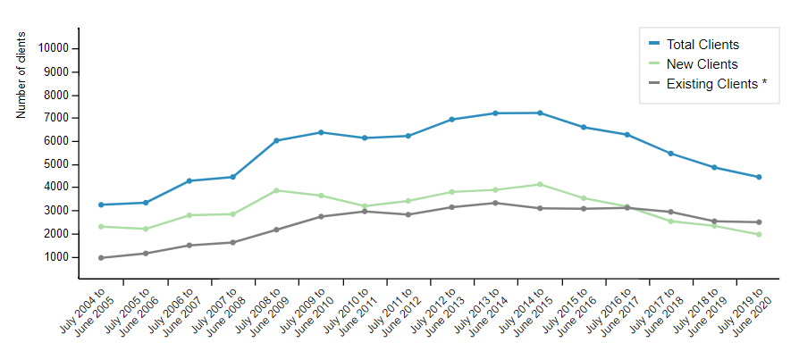
Utilisation of gambling harm services (excluding brief interventions)

Slide 12
Online gambling
  13% New Zealanders gamble online locally 2% offshore (HLS 2018)
  Access to online gambling for money has increased
  Levels increased during 2020 lockdown and remained
Research shows online gambling can increase young people’s vulnerability to gambling harm
In 2020/21 of the 4701 people seeking clinical help (excluding brief interventions):
      779 (17%) indicated that they had experienced harm from overseas/offshore gambling
    121 (3%) indicated that they had experienced harm from online gambling within NZ

Slide 13
Needs assessment key recommendations
Position the strategy within an overarching equity framework, and address inequities for Māori and ethnic-specific service providers and workforces
Increase opportunities for workforce development and cultural safety
Provide for more holistic and integrated services and supports.
Ensure clear public health messaging aligned with different cultural world views
Take action to reduce the stigma attached to gambling and gambling harm,
Continue to develop and test innovative service and support models
Continue to use research and evidence to inform our approach
Conclusion: strengthen support for priority populations young people / rangatahi

Slide 14
The Strategic plan

Slide 15
The strategic plan
Describes our goals and outcomes – what we want to achieve
Sets out priority areas and actions that we will focus on over the next three years
Includes stronger focus on equity and promoting health and wellbeing to address persistent inequities

Slide 16
Revised strategic framework
The new strategic framework consists of:
    a population outcome: Pae Ora – Healthy Futures
    a strategic goal: Promoting equity and wellbeing by preventing and reducing gambling-related harm.
    priority action areas aligned to key outcomes and objectives
Aligned with the public health approaches in
    Whakamaua: Māori Health Action Plan 2020-2025
    Kia Kaha, Kia Māia, Kia Ora Aotearoa: COVID 19 Psychosocial and Mental Wellbeing Plan.

Slide 17
Outcomes
[Iwi, hapū, whānau and Māori] Communities can exercise their authority to improve their health and wellbeing.
The health and disability system and wider system to prevent and minimise gambling harm is fair and sustainable and delivers more equitable outcomes for all.
The health and disability system and wider system to prevent and minimise gambling harm addresses racism and discrimination in all their forms.
The inclusion and protection of mātauranga Māori throughout the health and disability system.

Slide 18
Revised strategic objectives
Objective One: Create a full spectrum of services and supports
Objective Two: Shift cultural and social norms
Objective Three: Strengthen leadership and accountability to achieve equity
Objective Four: Strengthen the health and health equity of Māori, Pacific, Asian, and rangatahi
These proposed objectives align with those in the current strategy (Appendix 4)

Slide 19
The Service Plan

Slide 20
The Service Plan
Describes how we will achieve the strategic goal and objectives
Sets out the activities and services the Ministry will fund for the next three year:
  public health services
  clinical intervention and support services
  research and evaluation
  new services, innovation pilots and investments
  Ministry operating costs.

Slide 21
Prioritising Māori
The service plan proposes to prioritise Māori to:
      improve awareness of the risks and signs of gambling harm, how to seek help and making positive behaviour and lifestyle changes
      enable supportive conversations and challenge stigma;
      ensure services are designed collaboratively and inclusively, using co-design and lived experience
      research barriers to equitable service access and outcomes
It also proposes to prioritise investment to support Māori entering the gambling-harm workforce, including scholarships

Slide 22
Proposed additional investment
New initiatives
  a de-stigmatisation initiative focused on priority populations
  Scholarships for priority groups to enter the gambling harm workforce
  Developing a NZQA level 7 qualification covering gambling harm
Continue to develop innovative service models:
    Continue and progress the new service and innovation pilots to enable accessible and equitable services and supports
    Expand gambling harm peer workforce
Increasing the full-time equivalent (FTE) rate for gambling harm clinical intervention services.
Dedicated funding for Multi-venue Exclusion (MVE) Administration Service and database.

Slide 23
Public health services
New / increased investment:
  National de-stigmatisation initiative focused on priority populations
  Dedicated funding for Multi-Venue Exclusion Administration Service and database
  Continued investment:
  Public health services to empower people and communities
  Health and education promotion programme
  Gambling Harm Lived Experience Advisory Group
  National Coordination Service, public health workforce development and conference support

Slide 24
Clinical intervention services
New / increased investment:
  Increase the FTE rate for clinical gambling harm clinical intervention and support services with mental health and addiction clinical FTE rates
  Continued investment:
  Helpline and web-based services
  Workforce development, including cultural competency
  Data collection and reporting

Slide 25
Research and evaluation
Decreased investment:
  Reduction from $6.629 million to $3.832 million over 3 years (a reduction of $2.797 million)
  Research and evaluation strengthens the evidence base that supports all our work to prevent and minimise gambling harm
  We have been unable to commit all the research and evaluation funding allocated to this levy period (impacts of COVID-19)
  Some research and evaluation projects contracted during the current levy period will continue into the new levy period.
  Proposed research priorities include:
  prevalence data, longitudinal studies, gambling harm needs assessment
  addressing cultural barriers to equitable service access
  preventing and minimising harm from online gambling

Slide 26
New services, innovation pilots and investments
  Continue service and innovation pilots – with funding for next steps
  Pilots to addressing inequities for Māori and Pacific peoples and those living in isolated areas
  Develop and test innovative uses of technology to address gambling harm
  Increased investment to pilot and expand gambling harm peer workforce
  Pilot and implement a clinically robust model of care based on intensive treatment for people experiencing severe gambling harm.
  New workforce initiatives
  Developing a NZQA level 7 qualification covering gambling harm
  Scholarships to enable Māori, Pacific peoples, Asian peoples and people with lived experience of gambling harm (peers) to study and train to enter the gambling harm workforce

Slide 27
Estimated costs for 2022/23 to 2024/25
Estimated total costs are $67.374 million over three years
This an increase of $7.035 million compared with the total for the current strategy.
This increase will be made up by a $5.602 million underspend for the current period, plus additional new funding of $1.433 million over three years.
The underspend is forecast for the current period to 30 June 2022 due to delays in procurement as a result of COVID-19 response.
As a result, work from the current levy period will continue and be completed in the next levy period.

Slide 28
Indicative budget to prevent and minimise gambling harm (GST exclusive) 2022/23 to 2024/25
Service area | 2022/23 ($m) | 2023/24 ($m) | 2024/25 ($m) | Total ($m)
Public health services (harm prevention and minimisation) | 7.168 | 7.490 | 7.482 | 22.140
Clinical intervention and support services | 10.571 | 10.571 | 10.897 | 32.039
Research and evaluation | 1.079 | 1.383 | 1.370 | 3.832
New services, innovation pilots and investments | 2.477 | 2.257 | 1.691 | 6.426
Ministry operating costs | 0.957 | 0.990 | 0.990 | 2.937
Total ($m) GST Exclusive | 22.252 | 22.691 | 22.430 | 67.374

Slide 29
The problem gambling levy

Slide 30
What is the problem gambling levy for?
The problem gambling levy recovers the cost of the Ministry-funded services to prevent and minimise gambling harm and of the Ministry’s costs for implementing and managing those services.
The Act prescribes a levy formula which takes into account:
  forecast and actual expenditure over time
  any over or underpayments by each sector
  changes in each sector’s share of expenditure and presentations (as two proxy indicators of harm).

Slide 31
Problem gambling levy formula
Levy rate for each sector =
({[A x W1] + [B x W2]} x C) plus or minus R
D
W1 and W2 are weights for expenditure and presentations, the sum of which is 1.

Slide 32
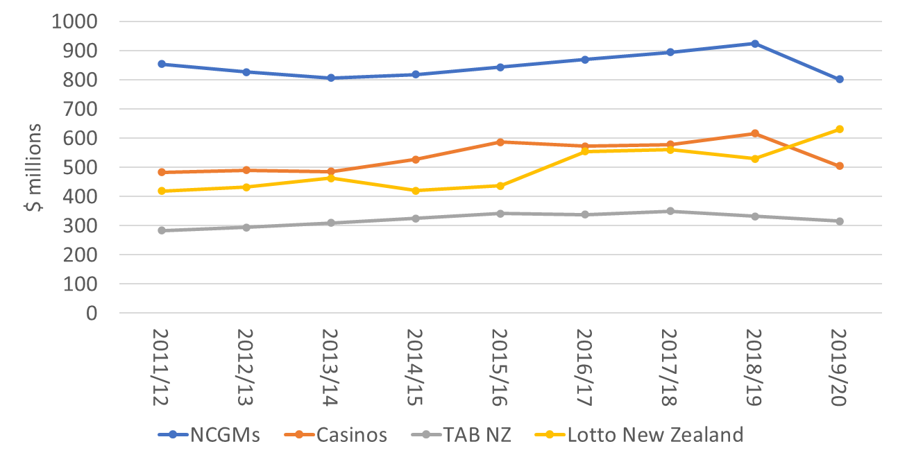
Expenditure by main gambling sectors 2011 - 2020
Source: Department of Internal Affairs

Slide 33
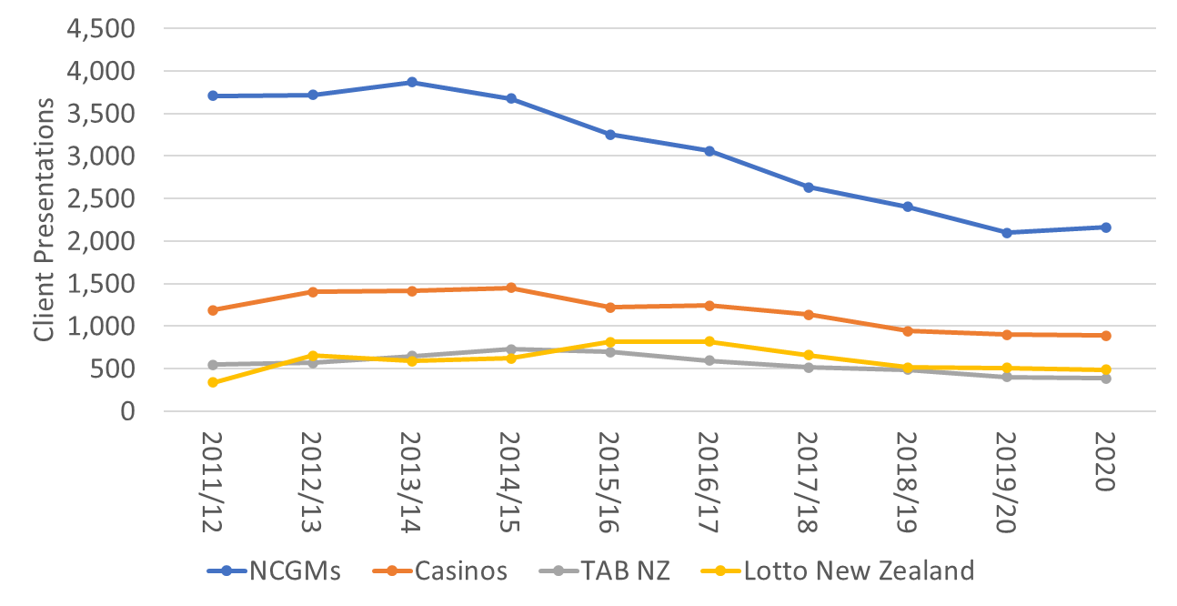
Presentations by main gambling sectors 2011 - 2020

Slide 34
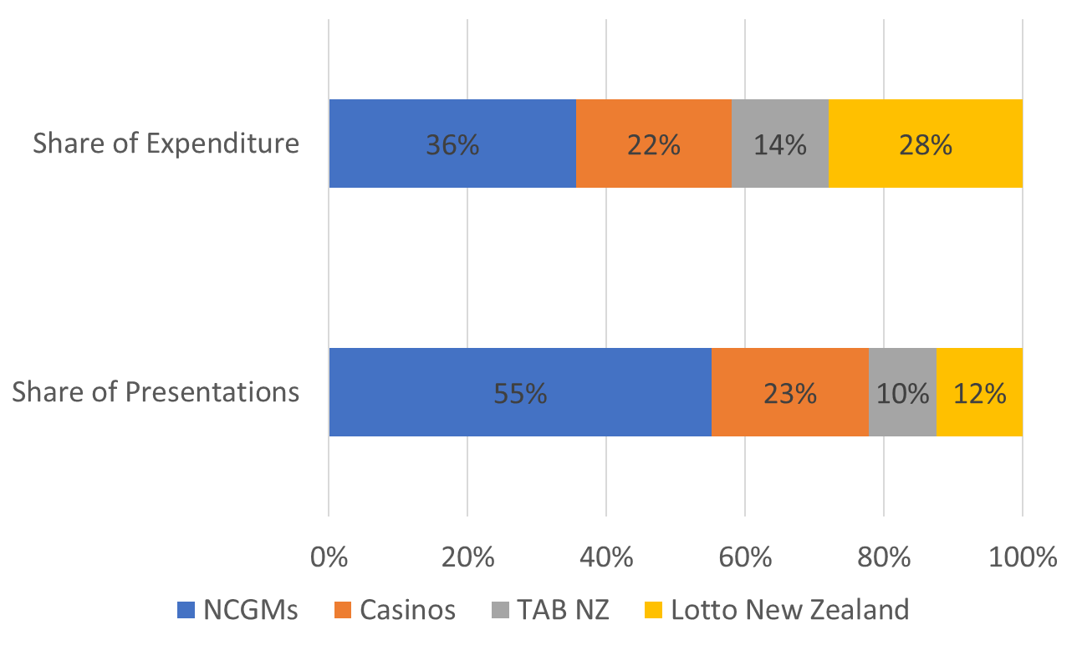
Share of presentations and expenditure by sector, for 2020

Slide 35
Expected levy payment ($m) per sector by expenditure/presentation weighting options
Presentation weighting % | NCGM | Casino | TAB NZ | Lotto NZ
30/70 current levy | 22.967 | 11.213 | 6.176 | 7.906
95 (Option 1) | 33.405 | 15.316 | 7.018 | 7.370
90 (Option 2) | 32.762 | 15.316 | 7.128 | 8.084
80 (Option 3) | 31.478 | 15.316 | 7.457 | 9.035
70 (Option 4) | 30.193 | 15.316 | 7.786 | 9.986

Slide 36
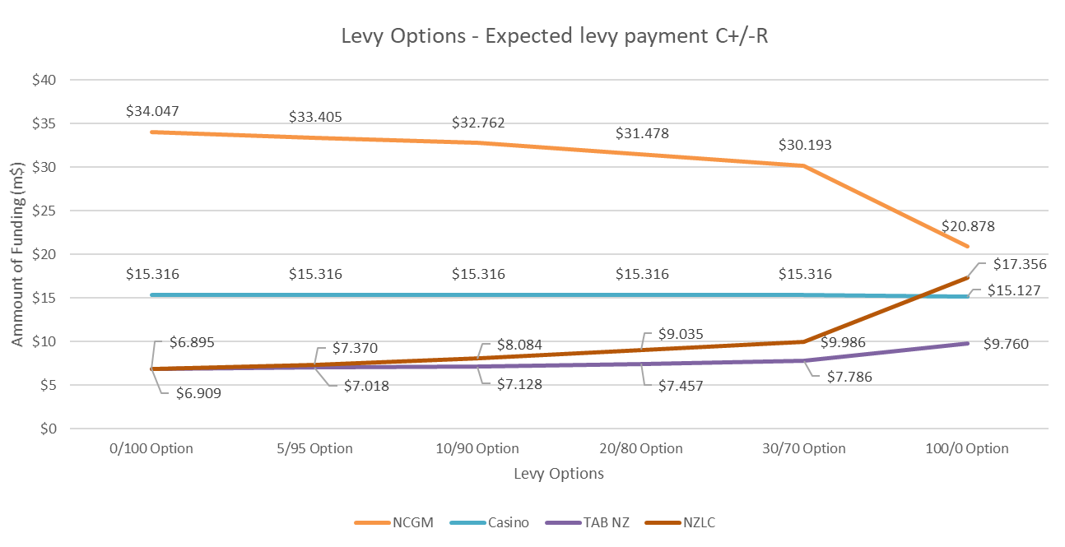
Expected levy payments as weightings change (expenditure/presentations)

Slide 37
Making a submission
The submissions form includes series of questions
Written submissions: Please include a copy of the submission form at the back of the consultation document.
Must be received by 5pm Friday 8 October (after that = not in analysis)
Prefer electronic copy:
    Online complete the online submission form available on the Ministry's consultation hub
    Email to gamblingharm@health.govt.nz either the submission form as Word document, pdf or short email
    For hard copy post to (allow time for it to be received by close-off date)
    Preventing and Minimising Gambling Harm Submissions
      Mental Health and Addictions
      Ministry of Health
      PO Box 5013
      WELLINGTON 6145.

Slide 38
Next steps
Submissions close 8 October 2021
Analysis of submissions and possible revision of draft Strategy
Updated levy calculations
Late November revised Proposals Document to Ministers & Gambling Commission
January 2022 Gambling Commission meeting and report
March 2022 Cabinet decisions on shape of strategy and levy
Late May 2022 (approximately) strategy and levy made public
1 July 2022 start of new strategy and levy
https://www.health.govt.nz/publication/draft-strategy-prevent-and-minimise-gambling-harm-2022-23-2024-25

Slide 39
Thank you
Questions & points for clarification?

