Slide 1


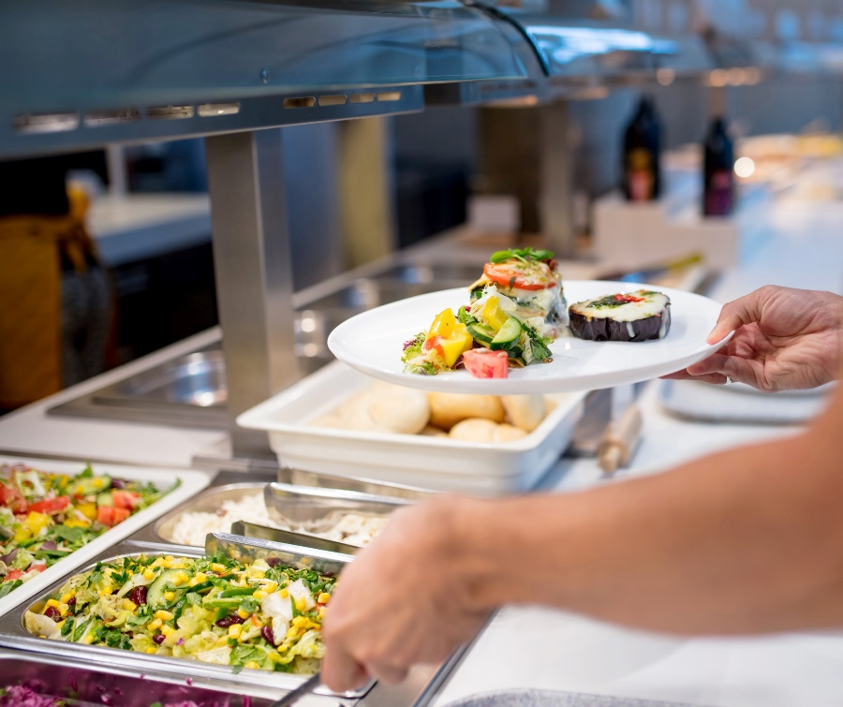
Healthy food in the workplace
Addressing the ‘why, what and how’

Slide 2

Why champion healthy food in our workplace?
it is a great way to prioritise the health
and wellbeing of staff
healthy eating is essential for good health
and supports a healthy, productive workforce
employees who believe their employer cares about their wellbeing are more engaged at work than others.
Notes:
Why bother championing healthy food in your workplace ?
(additional words in italics provide extra information and can be use to talk to the points in the presentation)
It is a great way to prioritise the health and wellbeing of staff (from a health and safety perspective)
Healthy eating is essential for good health and wellbeing, and (and there is evidence showing workplace healthy eating initiatives) supports a healthy, productive workforce
It is a way to consider environmental sustainability issues

Slide 3

What is healthy food?
many people have views on nutrition and healthy
eating.
in New Zealand the ‘go-to’ source, based
on current evidence, is the Ministry of Health’s Eating and Activity Guidelines for
New Zealand Adults.

Slide 4

What is a healthy food environment?
a healthy food environment supports and promotes healthy food choices
this means making healthy food available, accessible and affordable
a healthy food environment makes healthy food the easy choice.

Slide 5

What can we do in our workplace?
develop a healthy food and drink policy for our organisation
develop an implementation plan with staff input (eg, set up a working group).
Notes:
So what does that mean for your workplace?
(Using the EAGs definition of a healthy diet,) you can create a healthy food and drink policy that suits your organisation
(As part of creating a policy) you, as an organisation can decide what is in or out of scope.
(The next couple of pages has suggestions on what could be in and what could be out for you to consider…)

Slide 6

What is ‘in scope’?
all food and drink provided or funded
by the organisation
gifts, rewards and incentives funded
by the organisation
fundraisers for charity or other
promotion and support of breastfeeding
in the workplace.
Notes:
What is ‘in-scope’?
All food and drink provided or paid for by the organisation
(including:
-on site at any of the offices
- off site when a function is arranged or hosted for staff or visitors)
Gifts, rewards and incentives paid for by the organisation
Fundraisers for charity or other (where food and drinks are sold or intended for consumption, that have some connection with the organisation)
Promotion and support of breastfeeding in the workplace

Slide 7

What’s ‘out of scope’?
food and drink staff bring to work for their own consumption
gifts, rewards and incentives that are self-funded
self-catered meals that staff share – eg, birthday celebrations, self-funded off-site Christmas parties
gifts to staff from clients or customers
alcohol recommendations – refer to organisations alcohol policy.

Slide 8
How do we create a healthy food and drink environment?
The Healthy Food and Drink Guidance for Organisations:
is a framework for workplaces to create a healthy food environment for their staff and visitors
is based on the Ministry of Health's Eating and Activity Guidelines for New Zealand Adults
links to a Toolbox of resources with practical ideas to implement the Guidance.
Notes:
How do we create change in our workplace?
The Healthy Food and Drink Guidance for Organisations is a framework (especially designed) for workplaces to create a healthy food environment for their staff and visitors
(Based on the EAGs,) the Guidance contains lots of ideas for staff
There is also an online toolbox of resources that show you practical ways of putting the Guidance into action

Slide 9

Can we get more support?
Yes!
The Heart Foundation can provide support for organisations.
See Healthy Food and Drink Guidance for Organisations for details.
Notes:
Change to heading suggested to keep to the approach of the previous slides of asking from the perspective of the organisation.

